Slide 1
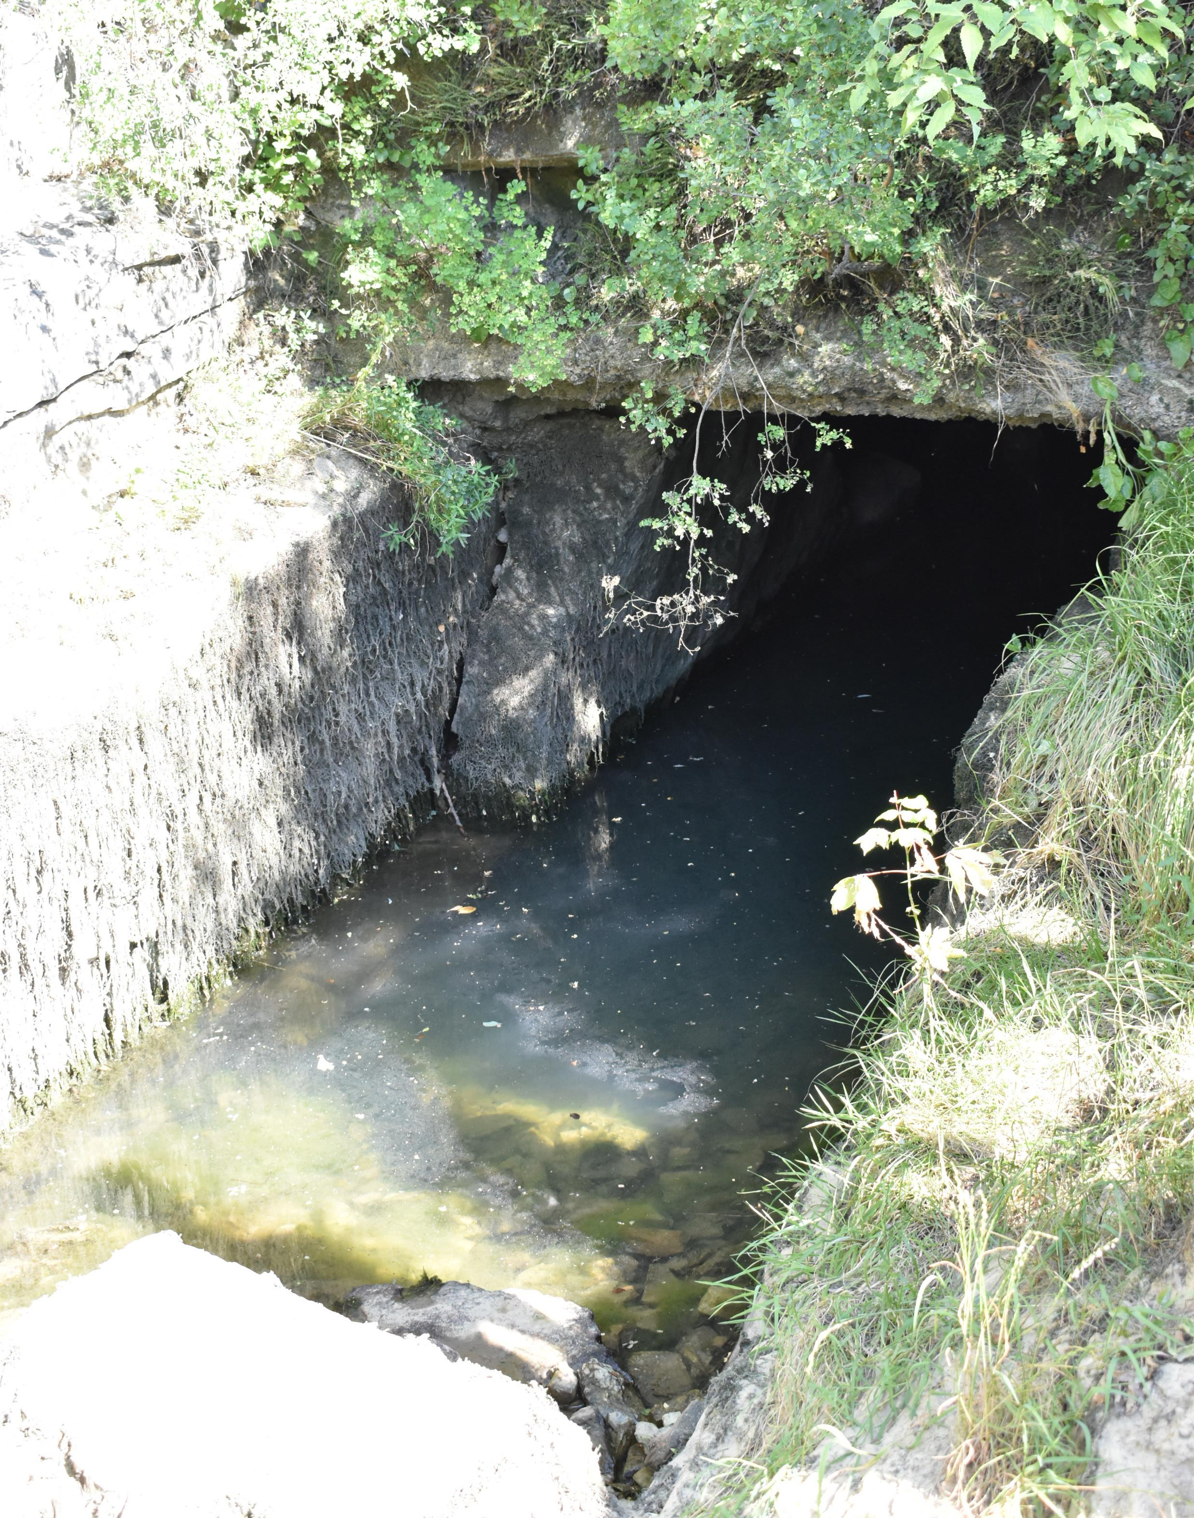
SESSION 3 (18 June 2019): Water Resources Quality & Management
Mallary dueñas
25 July 2019
(Photo: M. Dueñas)
Notes:
Our world is comprised mostly of water and our island is surrounded heavily by water. On such a remote island limited to access by our neighbors in the mainland, we know supplies for our survival are quite scare. This scarcity applies to our drinking water source as well. Most of our thoughts are not directed to the question of whether tomorrow will or will not be our last day to drink but of whether our water source is actually safe to drink. This question falls back on the island’s water quality and management of its water resources, especially the Northern Guam Lens Aquifer (NGLA). Local government and private party groups continuously work towards bringing the people the best quality of water for their best quality of life. Let’s look at some ways in which our distant neighbors in Europe go about conducting research of their local karst aquifers.

Slide 2
Outline – Session 3
From monitoring to management of karst groundwater resources
Natural attenuation of pollution in karst – a geochemical, chemical and microbial investigation in the Carpathian Mts., Romania
Microplastic pollution in karst environment
Monitoring and methods to assess the groundwater quality degradation risk in karstic island aquifers (Bantayan Island, Cebu Province, Philippines)
Karst hydrogeological investigations in the Bükk Mountains (NE Hungary)
Groundwater geochemistry of the hypogene karst systems in Mariovo, Macedonia

Slide 3
M. Sinreich (Switzerland) “From monitoring to management of karst groundwater (GW) resources”
Determine increases of present microbiological groups, impacts and influences of ground surface, and if other pathogens take same pathways as others.
Contrasting vulnerability mapping/protection zoning (e.g., EPIK and COST 620) assessment/validation (qualitative and process-based)
[ Interactive link ]
Notes:
Mr. Sinreich and his colleagues monitored the deterioration of karst springs affected by fecal contamination of bacteria and pathogen groups available within each system and examined their impacts to the qualitative, quantitative, and ecological properties of the groundwater resource.
If you had a one-liter representative sample from one of the springs, they looked at how the groups present in the water increased or decreased with respect to variability in hydrological conditions. That with increase of bacteriological forms the karst groundwater would be susceptible to continuous vulnerability.
Contrasting vulnerability assessment/validation (qualitative and process-based):
Dye tracing
Catchment, flow velocity, and storage of topsoil/vadose zone
Recovery times
Transport/attenuation processes
Sinreich, M., Pronk, M., & Kozel, R. (2013). Microbiological monitoring and classification of karst springs. Environmental Earth Sciences, 71(2), 563–572. doi:10.1007/s12665-013-2508-7

Slide 4
M. Sinreich (Switzerland) “From monitoring to management of karst groundwater (GW) resources”
Contrasting vulnerability mapping/ protection zoning assessment/ validation
(Sinreich & Pochon, 2015, p. 134)

Slide 5
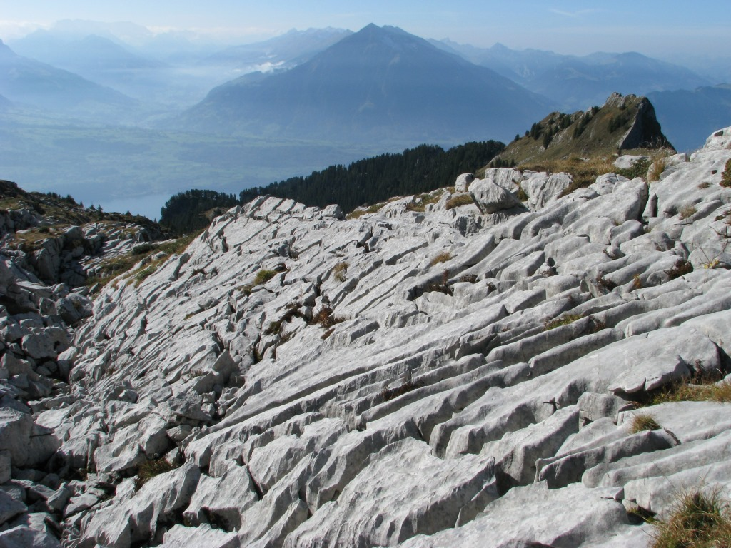
M. Sinreich (Switzerland) “From monitoring to management of karst groundwater (GW) resources”
https://karst.iah.org/files/2018/01/17-Karrenfield-Swiss-Alps.jpg
(Photo: T. Aguilo)
Notes:
Inject dye (tracing experiment) through topsoil layer starting at higher elevation area then select sites at lower elevations.
Determine catchment and flow velocity without interrupting the surface soil by digging or drilling
Using a relative size amount of water, land surface is irrigated with water and degree of storage in each protective layer of upper saturated zones to be determined.
After irrigation, transit and recovery times determined where it was determined that times were similar travelling through soil layers, but degree of recovery were different.
Through vulnerability mapping, determine transport/attenuation processes via:
Comparative tracing approach
Source definition
Sub-system specification
Conservative reference and reactive proxy tracers to determine relative concentration over injection time (days)
Challenges:
Emerging contaminants and non-conventional parameters (molecular host-specific)
Ongoing understanding of monitoring data – early stages still need to delineate their meanings
GW protection zonings may not be appropriate for karst
Other Challenges:
Understanding the quantitative evaluation and process;
understanding contaminant-specific assessments and even the implementation in different parts of the world (conflicts/transboundary aspects)
understand the quality of each system during baseflow, moderate and strong recharge events including characterizing hydrogeological properties of the system
Sinreich M., Pochon A. (2015) Standardized Approach for Conducting Tracing Tests in Order to Validate and Refine Vulnerability Mapping Criteria. In: Andreo B., Carrasco F., Durán J., Jiménez P., LaMoreaux J. (eds) Hydrogeological and Environmental Investigations in Karst Systems. Environmental Earth Sciences, vol 1. Springer, Berlin, Heidelberg

Slide 6
(Photo: T. Aguilo)
Notes:
Scenario 1 – equal distribution through infiltration; not enough/permanent leakage into the lower aquifer; concentration throughout is dispersed
Scenario 2 – dispersed, yet uneven distribution but highly concentrated in an area, which could lead to further percolation to groundwater or disperse horizontally and negatively affect impacted soil layer as well as those beneath it
Scenario 3 - If source released beneath soil layer, e.g. sewage pipeline, build-up of contaminants creates a highly concentrated area where contaminants may be pushed down by gravity and percolate to lower layers, while being further dispersed through fractures and conduits leading to the accumulation or presence of contaminants within a water resource.
Sinreich M., Pochon A. (2015) Standardized Approach for Conducting Tracing Tests in Order to Validate and Refine Vulnerability Mapping Criteria. In: Andreo B., Carrasco F., Durán J., Jiménez P., LaMoreaux J. (eds) Hydrogeological and Environmental Investigations in Karst Systems. Environmental Earth Sciences, vol 1. Springer, Berlin, Heidelberg

Slide 7
M. Sinreich (Switzerland) “From monitoring to management of karst groundwater (GW) resources”
Contrasting vulnerability mapping/ protection zoning assessment/ validation
(Photo: T. Aguilo)
Notes:
Through vulnerability mapping, determine transport/attenuation processes via:
Comparative tracing approach
Source definition
Sub-system specification
Conservative reference and reactive proxy tracers to determine relative concentration over injection time (days)
Challenges:
Emerging contaminants and non-conventional parameters (molecular host-specific)
Ongoing understanding of monitoring data – early stages still need to delineate their meanings
GW protection zonings may not be appropriate for karst
Other Challenges:
Understanding the quantitative evaluation and process;
understanding contaminant-specific assessments and even the implementation in different parts of the world (conflicts/transboundary aspects)
understand the quality of each system during baseflow, moderate and strong recharge events including characterizing hydrogeological properties of the system

Slide 8
M. Sinreich (Switzerland) “From monitoring to management of karst groundwater (GW) resources”
Contaminant source(s)
Environmental Management Process
Monitoring
Spatial/temporal system vulnerability
Contaminant-specific transport & Storage
Source Definition
(Illustration: M. Dueñas)
Notes:
Address transport/attenuation (weakening) processes through environmental management processes:
potential contamination sources
Areas exposed and vulnerable to contaminant and their degrees of impact
Determine the definition of a “source” perhaps as the point or nonpoint source, e.g.
Whether the methods and research applicable to contaminants or specific types of contaminants
Conduct monitoring via investigations, research, literature work and even analyses
Throughout the determination process return to the potential sources of contamination

Slide 9
A. Persoiu (Romania) “Natural attenuation of pollution in karst – a geochemical, chemical, and microbial investigation in the Carpathian Mts., Romania”
Pollution in karst springs and rivers
Characterization Methods:
TDS, E.coli, pH, nitrate, nitrite, ammonia, and isotopes (carbon-13, oxygen-18, hydrogen-2) analyses
Seasonal microbiological (DNA/RNA) and chemical (30 metal and metalloid) analyses
[ Interactive link ]
(Brad, Fekete, Şandor, & Purcărea, 2015, p. 196)
Notes:
Aquifers are often contaminated by the existing microbiological organisms and pathogens living within its ecosystem. Even so, the introduction of runoff pollution from storms and heavy rains contributes greatly to the increases and movement of these organisms through the water and out to springs used as the local drinking water resource.
For this reason, microbiological, chemical, and geochemical characteristics were examined to determine whether biodegradation of pollutants occurs at spring sites. Also at each of the springs, they examined the potential for natural attention processes (natural clean-up or biodegradation processes) of pollutants.
Brad, T., Fekete, A., Şandor, M. S., & Purcărea, C. (2015). Natural attenuation potential of selected hydrokarst systems in the Carpathian Mountains (Romania). Water Science and Technology: Water Supply, 15(1), 196–206. doi:10.2166/ws.2014.092

Slide 10
(Photo: Brad, Fekete, Şandor, & Purcărea, 2014, p. 204)
upstream
downstream
Notes:
Examine pollution in karst springs and rivers and determine degradation resulting from microbial activity
ARDRA – amplified ribosomal DNA restriction analysis
DGGE – denaturing gradient gel electrophoresis
Results:
During seasonal changes some microbiological representatives were present upstream but disappeared downstream and vice versa.
appearance of new microorganisms downstream of the occurred mostly during autumn, when the amount of water flowing through karst was lower than spring. More common bacterial species are expected at higher water levels in spring due to intense turbulent mixing and other factors.
High oxygen and hydrogen isotope results were assessed, and it was suggested that they were due to longer transient times
On-going investigation led to the conclusion that stable isotopes could be possibly due to an equilibrium of oxygen in water with that of the host karst rock and matrix flow was an important contributor.
Chemistry-wise, downstream decrease of pollutants were observed as well as dilution by tributaries and the matrix water. “Suggest that karst can have a significant potential for natural attenuation by retaining the pollution underground, in combination with biodegradation performed by microorganisms.”
Brad, T., Fekete, A., Şandor, M. S., & Purcărea, C. (2014). Natural attenuation potential of selected hydrokarst systems in the Carpathian Mountains (Romania). Water Science and Technology: Water Supply, 15(1), 196–206. doi:10.2166/ws.2014.092

Slide 11
L. Valentic (Slovenia) “Microplastic pollution in karst environment”
Anthropogenic and plastic pollution in karst systems
Microplastics = <5mm diameter (literature-based)
Methods
Water sampling (micro-meshed nets, precipitation catchments in containers, water bottles)
Sediment sampling for metal analysis determinations
Microscope & Infrared Spectroscopy
[ Interactive link ]
Notes:
Synthetic polymers started more than a century ago and continues to be the fastest growing anthropogenic pollution with at least 6.4 million tonnes of wastes in the ocean. Most extensive research has been studied in oceans but minimal to no data available for that of karst systems.
Various sources of microplastic pollution underground:
Sinking rivers: WWTP (sewage and landfills – ordot dump, e.g.), fabrics from sponges and clothing
Percolating rivers: landfills, agricultural soils, WWTP sludges, tire shavings from runoff
Particular to Postojna, cave tourism
Valentić, Lara. Analiza mikroplastike v izbranih površinskih in podzemeljskih kraških vodah. Diss. Univerza v Novi Gorici, Fakulteta za znanosti o okolju, 2018.

Slide 12
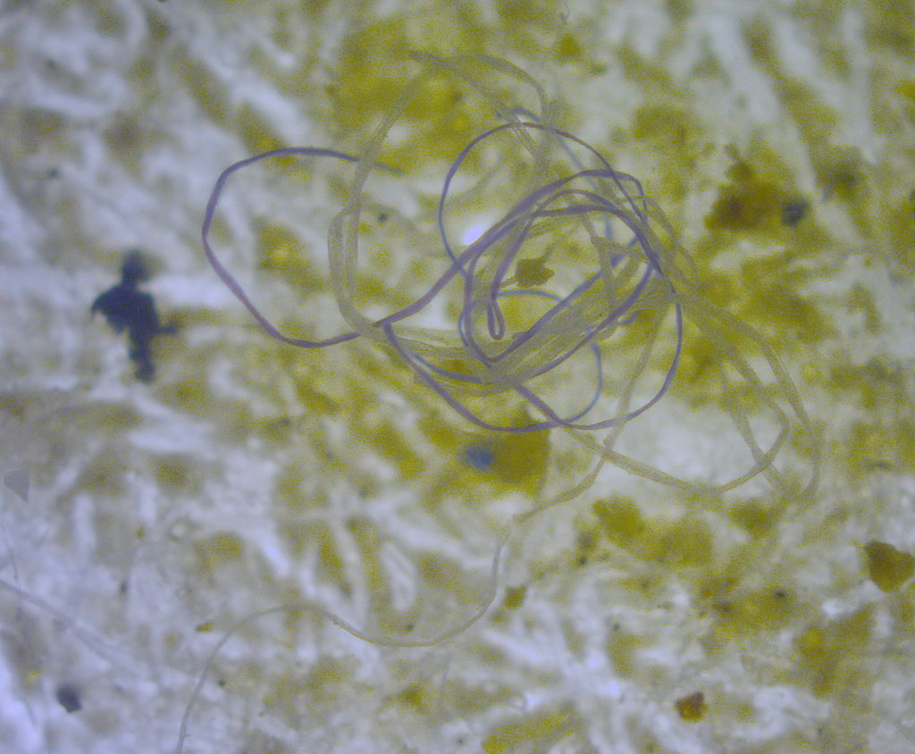
https://cdn.downtoearth.org.in/library/large/2018-04-30/0.31378000_1525107918_screen-shot-2018-04-30-at-10.png
https://www.popsci.com/resizer/1aVMfUry5RUXEPdfm0vApgR5lLk=/600x400/arc-anglerfish-arc2-prod-bonnier.s3.amazonaws.com/public/WEMMIBBKOF2J3US257RKWIUSLM.jpg
http://oceanservice.noaa.gov/facts/microplastics.jpg
https://upload.wikimedia.org/wikipedia/commons/thumb/0/0d/Snap-40.jpg/1024px-Snap-40.jpg
https://marinedebris.noaa.gov/what-are-microplastics-microfibers
Notes:
Microplastics are pieces of plastic less than 5mm (~ 0.20 in) long

Slide 13
(Valentić, 2018, p. 28)
Notes:
Results
Microplastic fibers discovered in Skocjan, Kocina, and Postojna caves (two of which are tourist-based)
IR-spectra revealed correlations of peaks in caves where fibers present
Rimstone pools had elevated results due to longer collection times
46.2% of Postojna cave polluted while Skocjan area was 53.8% polluted
Repeatability? Only 3 rainfall samples taken per location?
Water is going through the underground karst systems but method may need to be changed and was not considered effective by researchers
Valentić, Lara. Analiza mikroplastike v izbranih površinskih in podzemeljskih kraških vodah. Diss. Univerza v Novi Gorici, Fakulteta za znanosti o okolju, 2018.

Slide 14
(Valentić, 2018, p. 29)
Notes:
- Results
26 fibers found in postojna cave and 17 confirmed as microplastics
In rainfall samples, 2 analyzed and 1 identified
In surface streams, 15 analyzed and 1 identified
In skocjan cave, 136 analyzed and 87 identified
In kocina cave, 4 analyzed and identified
In cave jama 1 v konjaducah none found
In rain skocjan, 12 analyzed but 5 identified
Surface stream in skocjan, 7 analyzed and 5 identified
Valentić, Lara. Analiza mikroplastike v izbranih površinskih in podzemeljskih kraških vodah. Diss. Univerza v Novi Gorici, Fakulteta za znanosti o okolju, 2018.

Slide 15
(Valentić, 2018, p. 42)
Notes:
Analysis of samples from Postojna cave
under microscope
All measured were short, small, and microscopic, which was challenging but most were plastic but need to change analyzer
Infrared spectra
More in rimstone pools due to longer collection time
46.2% of postojna cave (which can get up to about 2 million visitors) polluted in both regions and tourism activities contributed to the pollution in underground environment, while skocjan area is 53.8% polluted.
Question: does microplastic concentrate in other karst habitats (lakes, springs) and what are the impacts to living organisms to determine the source of these pollutions?
Valentić, Lara. Analiza mikroplastike v izbranih površinskih in podzemeljskih kraških vodah. Diss. Univerza v Novi Gorici, Fakulteta za znanosti o okolju, 2018.

Slide 16
Robert DiFilippo (United Kingdom) “Monitoring and methods to assess the groundwater quality degradation risk in karstic island aquifers (Bantayan Island, Cebu Province, Philippines)”
Effects of salt-water intrusion and mismanagement of karst resources
Results
Some wells reaching 15-20m into lens while hand-dug wells (deepest of 58m) reached a meter
Water quality analysis
Seasonal water movement/mechanism fluctuations
[ Interactive link ]
Notes:
Research to change paradigms
Need to link research and information to the community and government.
Aim:
Assess the impact of salt-water intrusion on karst island water resources through the application of a freshwater lens assessment protocol integrated into a participatory adaptive water resource management framework for stakeholder engagement, and to test the efficacy of the protocol and its ability to produce viable output for improved management of the freshwater lens.
DIFILIPPO, R., SMOUT, I.K. and BOSHER, L.S., 2018. Implementation of a freshwater lens assessment protocol on karst islands. IN: Shaw, R.J. (ed). Transformation towards sustainable and resilient WASH services: Proceedings of the 41st WEDC International Conference, Nakuru, Kenya, 9-13 July 2018, Paper 3055, 6pp.

Slide 17
DiFilippo, Smout, & Bosher, 2018, p. 4)
Notes:
Things to overcome during this study especially with minimal resources:
Evidence of mismanaged natural resources
Minimal understanding of water resource beneath the island
Created a geological map of entire island with all representative wells minus those owned by private companies
Self analyzed samples for qualitative properties
Conducted interviews with locals especially for usages of drinking water source
DIFILIPPO, R., SMOUT, I.K. and BOSHER, L.S., 2018. Implementation of a freshwater lens assessment protocol on karst islands. IN: Shaw, R.J. (ed). Transformation towards sustainable and resilient WASH services: Proceedings of the 41st WEDC International Conference, Nakuru, Kenya, 9-13 July 2018, Paper 3055, 6pp.

Slide 18
(DiFilippo, Smout, & Bosher, 2018, p. 3)
Notes:
Challenges:
Working on a vulnerability index map to show production wells impacted by up-coning and drawing up saltwater, which anything above 250mg/L chloride is deemed undrinkable by the gov’t. However, it is a mgmt issue. Some living among perimeters may be impacted by politically-motivated decisions because of their location away from the main recharge zone.
DIFILIPPO, R., SMOUT, I.K. and BOSHER, L.S., 2018. Implementation of a freshwater lens assessment protocol on karst islands. IN: Shaw, R.J. (ed). Transformation towards sustainable and resilient WASH services: Proceedings of the 41st WEDC International Conference, Nakuru, Kenya, 9-13 July 2018, Paper 3055, 6pp.

Slide 19
Notes:
DIFILIPPO, R., SMOUT, I.K. and BOSHER, L.S., 2018. Implementation of a freshwater lens assessment protocol on karst islands. IN: Shaw, R.J. (ed). Transformation towards sustainable and resilient WASH services: Proceedings of the 41st WEDC International Conference, Nakuru, Kenya, 9-13 July 2018, Paper 3055, 6pp.

Slide 20
Z. Fekete (Hungary) “Investigation of karst hydrogeological characteristics in the Bukk Mountain (NE Hungary)”
Hydrogeological characteristics of karst systems in complex geological and hydrologic settings involving karstified limestone
Monitoring for 27 years with 80 points/stations (weather, springs, caves, wells, injection wells, thermal wells)
Fast/slow flows in springs using:
Hydraulic head
Flow
Cross correlations, cross-amplitudes and coherence, and phase and gain spectrum
Depth ranges of fast flow (vadose), baseflow and intermediate flow
Notes:
Bukk Mountain
100-950m amsl elevation range
Found within a national park and is a major source of water supply to two aquifers
Complex geologic and hydrologic settings that involves karstified limestone and large number of caves
Features different topographical features: Jurassic limestone and even dolomites
Monitoring system in place for 27 years of observation with over 80 monitoring points (weather stations, springs, caves, observation wells, pumping/injection wells, and thermal wells)
Water levels/pressures, temperatures and electrical conductivity data obtained
Monitored fast/slow flows in both springs using autocorrelation of hydraulic head and flow, cross correlation, cross-amplitudes and coherence, and phase and gain spectrum to determine the division of fast and baseflow intermediate flow, flow times and rates. Also, include depth range of fast flow (vadose), baseflow and intermediate flow.
Used flow, hydraulic head, and precipitation data for presentation but not electrical conductivity data for this particular research.

Slide 21
M. Temovski (Macedonia) “GW geochemistry of the hypogene karst systems in Mariovo, Macedonia”
Apply GW geochemistry to understand hypogene karst systems and compare with speleogenetic information obtained from caves
Methodology:
Field measured temperature, pH, and E.coli
Chemical composition + trace elements (e.g. arsenic)
Isotopes (e.g. tritium)
Groundwater age – isotopes and noble gas concentrations
[ Interactive link ]
Notes:
Hypogene – below earth’s surface
Epigene – taking place at the earth’s surface
Hypogene versus epigene in karst recharge systems and determine conceptual models for karst systems and their hydrogeological features and functions.
Hydrothermal dissolution (cooling of rising thermal waters along basin boundaries). Source of water fed from surface and source of acidity comes from soil surface and hypogene systems fed from below and different sources of acidity.
Springs discharging into epigene and mixing in GW systems
Hydrogeological control and geothermal gradient connected to extensional tectonic evolution
Mariovo hypogene karst sinking rivers:
Main speleognetic mechanism cooling of rising CO2-rich thermal waters, locally coupled with additional processes
Sulfuric acid speleogenesis (postojna) – MND: impact of acids other than carbonic acid to cave formation processes and reduced sulfur compounds can be beneficial energy source to microorganisms
Ghost-rock weathering (Karsi Podot Cave) – MND: chemical weathering and selective dissolution and removal of soluble species then mechanical erosion of undissolved
Assumption: temp. indicates younger components and cretaceous limestone but based on dissolution it is assumed that rock basically dolomite. Also, heat source within the area caused by volcanic activity as it about 10-15 km from the studied location and each of the springs close revealed high arsenic values.
Temovski, Marjan & Palcsu, László. (2018). Geochemical characteristics of some thermal karst springs – insight into the hypogene karst systems in Mariovo, Macedonia.

Slide 22
(Photo: Thomas Aguilo)

Slide 23
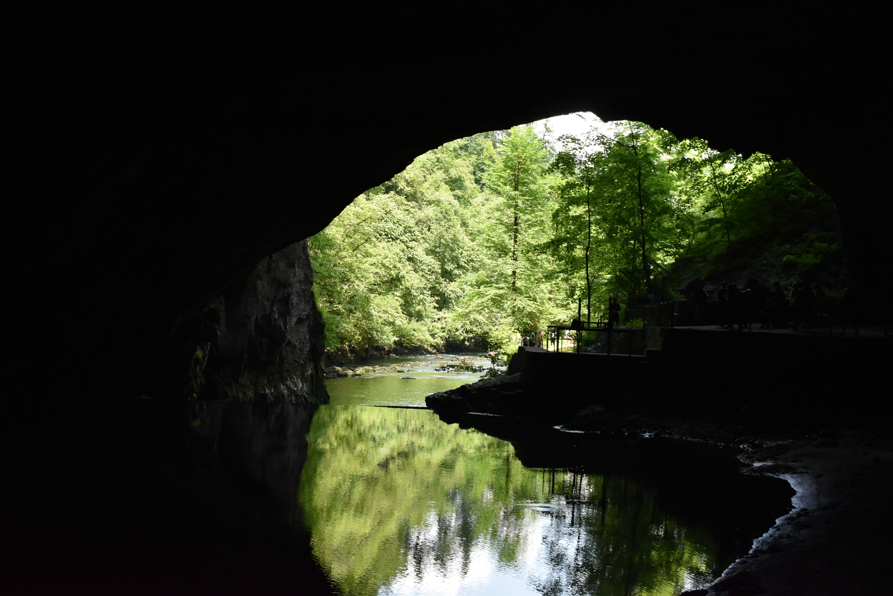
THANK
YOU!
(Photo: M. Dueñas)

Slide 24
Acknowledgements

