Slide 1


Northern Guam Lens Aquifer
Groundwater Modeling Program: configuring sustainable water production limits
D.G. Superales, N.C. Habana, Y.S. Kim, J.W. Jenson, and S.B. Gingerich
Water & Environmental Research Institute of the Western Pacific, University of Guam
Pacific Island Water Science Center, US Geologic Survey

Slide 2
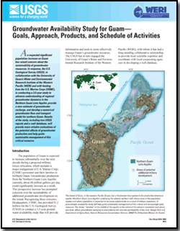


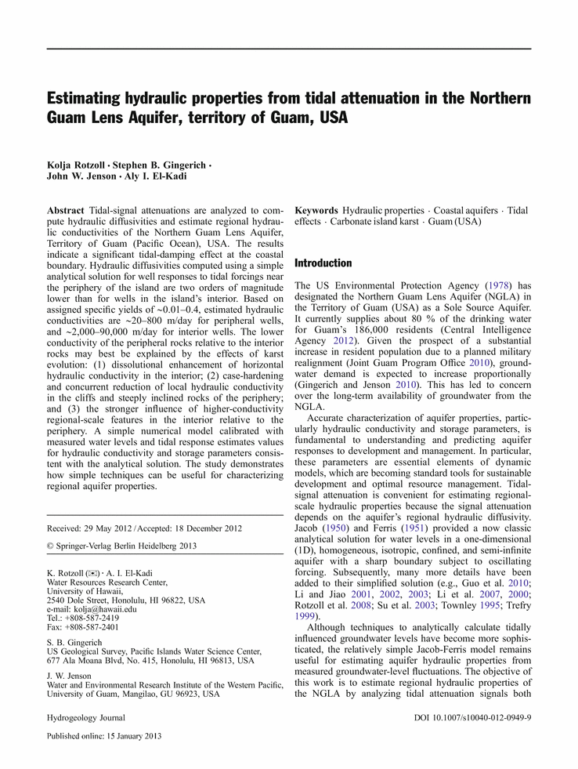
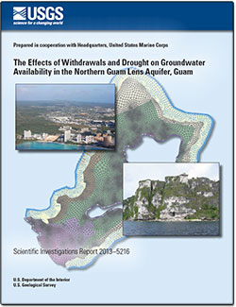
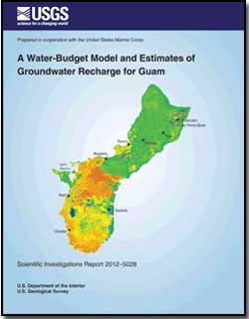
Previous Works – 2010 to 2014
USGS
WERI
The Effects of Withdrawals and Drought on Groundwater Availability in the Northern Guam Lens Aquifer, Guam.
By Gingerich, Stephen
http://hi.water.usgs.gov/publications/pubsguam.html

Slide 3
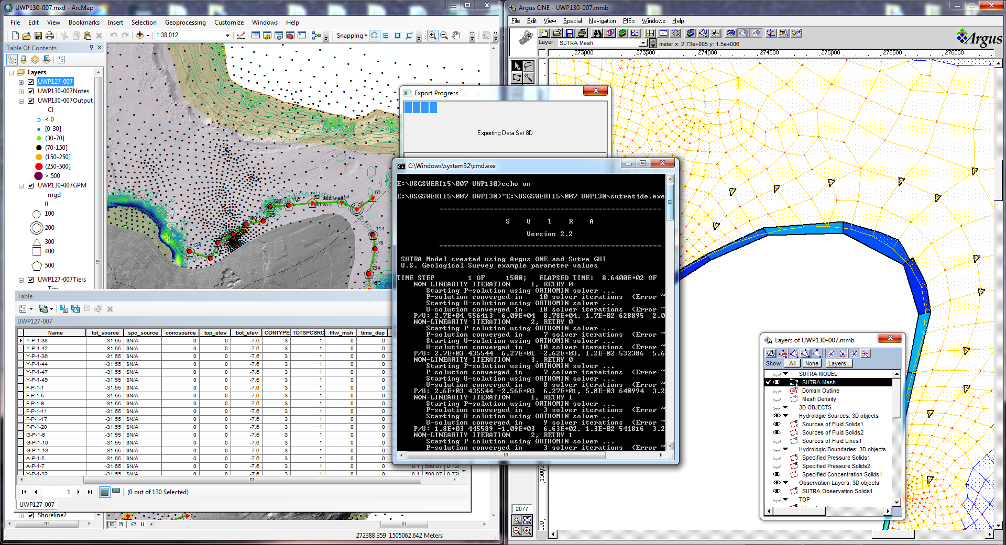
Modeling Parabasal Yield:
Argus ONE, SUTra, GW Chart, GIS, Notepad Plus, and Excel

Slide 4
Results

Slide 5
Andersen
Agafa Gumas Basin
Andersen Basin

Slide 6
AG, Finegayan
Agafa Gumas Basin
Finegayan Basin

Slide 7
Yigo Trough
Finegayan Basin
Yigo Basin

Slide 8
YT, Mangilao, NH
Yigo-Tumon Basin
Mangilao Basin
North Hagatna Basin

Slide 9
Natural Limits – South Hagatna
South Hagatna Basin
Pago-Adelup Fault

Slide 10
Ultimate Yield ?
Ultimate Yield
UY
well x_{n}
well x_{n-1}
...
MGD?
Q, [Cl⁻] < 250 mg/l
well x₄
well x₃
well x₂
well x₁
t

Slide 11
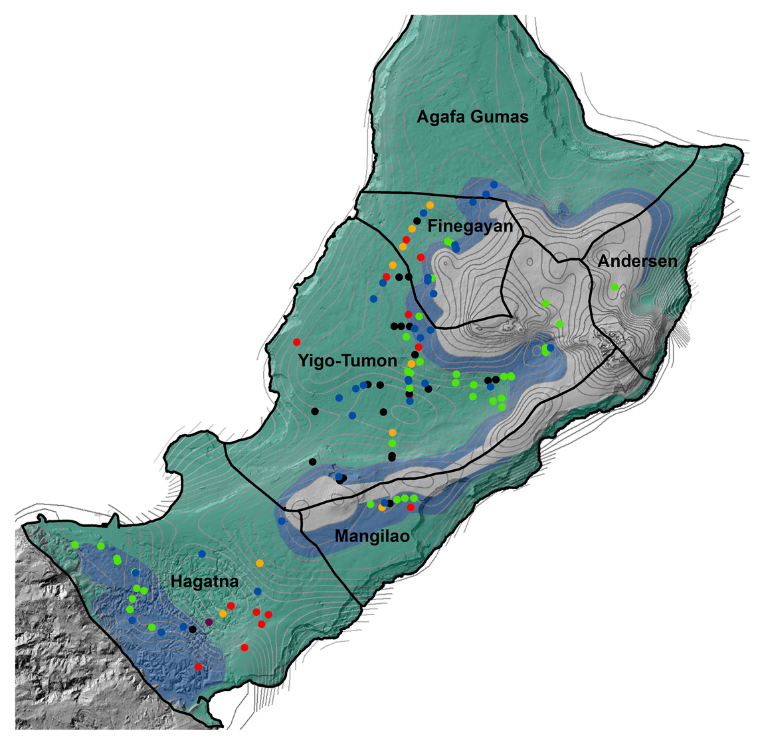
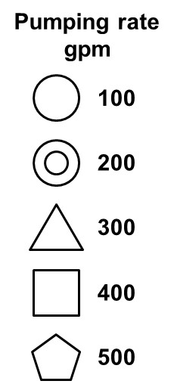
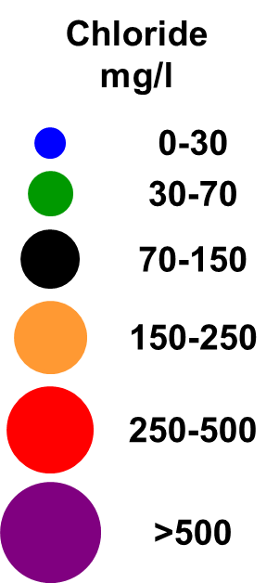
The Imaginary System
Notes:
We’ve installed a picket fence of about 100 wells in the para-basal zone to intercept all of the water descending from the supra-basal zone, thus targeting the 25% of the recharge that descends in these two zones…
We’ve also installed a couple dozen to intercept the para-basal water that descends down the Adelup Fault, at the southwest end of the aquifer.
For comparison, here is the map again of the actual system [bring up map]
Here is a summary of the differences between the two systems [first table, pause for them to read]
Note that the total extraction of the imaginary system is nearly double that of the actual system.
Let’s look now at the extraction efficiencies, zone-by-zone [second table]
Here is the result that, so far, has surprised us [circle]
Our picket fence captures 100% of the recharge from the para- and supra-basal zones—none escapes
And it captures 12% of the basal zone’s recharge—in what has to be reversed flow along the boundary!
Interestingly—that’s the same amount that the actual system captures from the basal zone.
Note that the actual system only gets 34% of the para-supra-basal recharge—and that the basal zone provides half of its total extraction…..

Slide 12
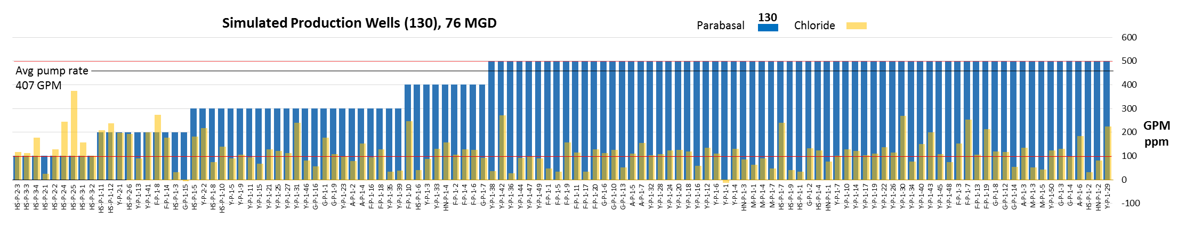
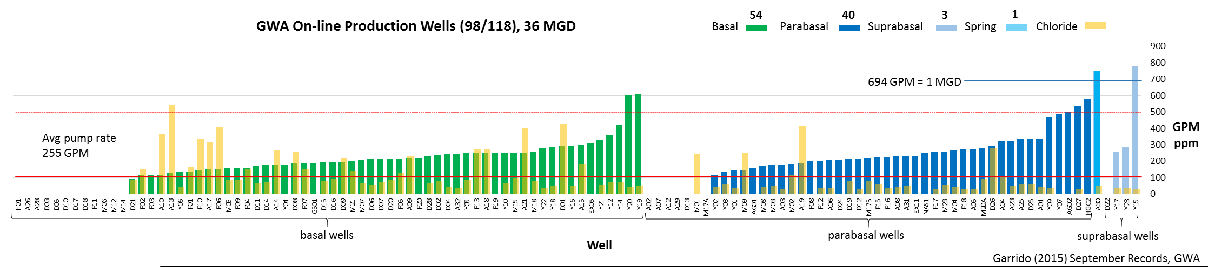
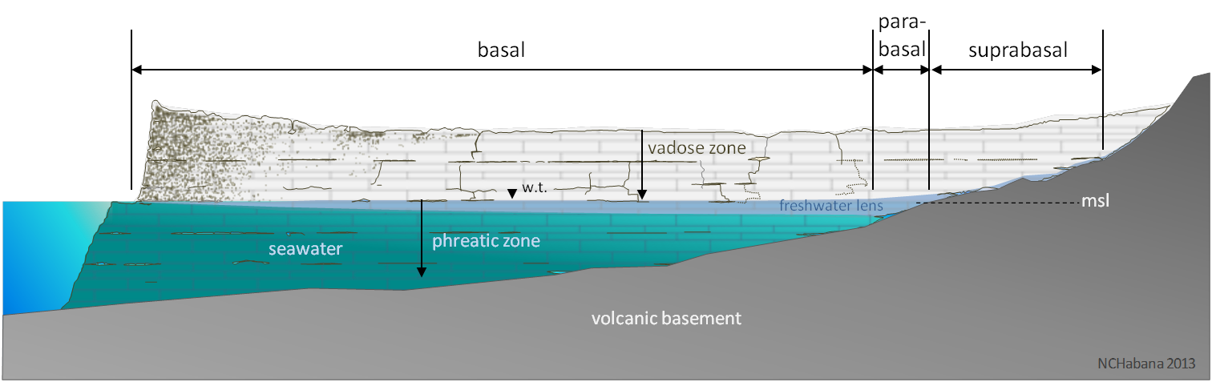
The Imaginary System
Notes:
Here is a graphic comparison of the two systems:
The actual system is in the middle, the Imagineered system on the top. Dark blue bars show the pumping rates of wells IN THE PARA-BASAL ZONE—which in the imaginary system is ALL of them.
The actual system has a few more basal wells than para-basal, with a similar pumping profile.
It also has a few wells, including its highest producing—and best quality—wells actually inside the supra-basal zone.
The gold bars show the chloride concentrations—actual and simulated—for each well…..

Slide 13
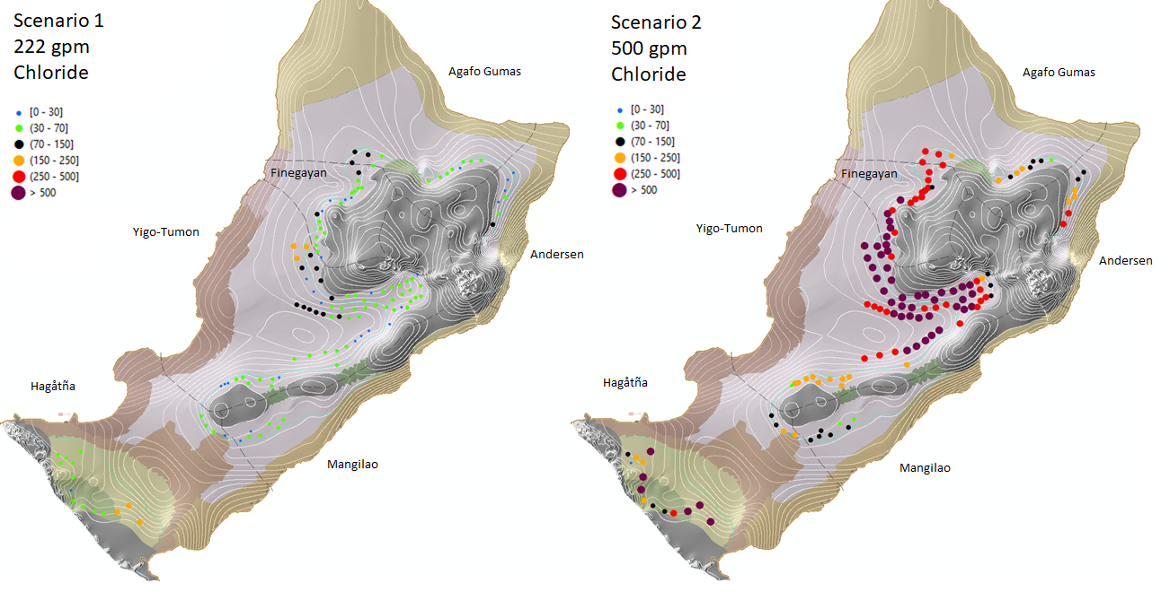
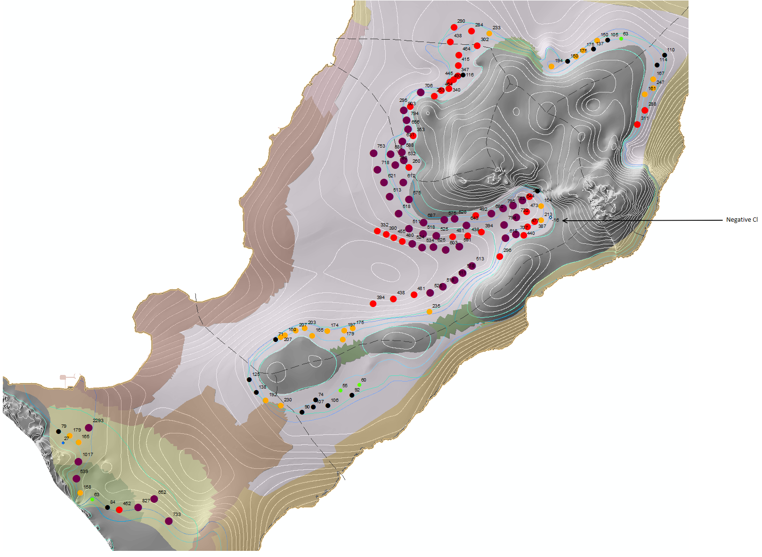
Phase 4
222 gpm
130 wells
42 MGD
500 gpm
130 wells
93 MGD

Slide 14
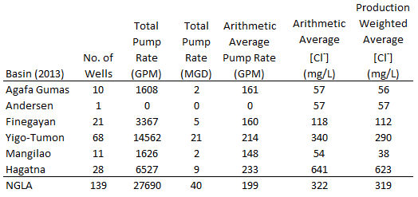
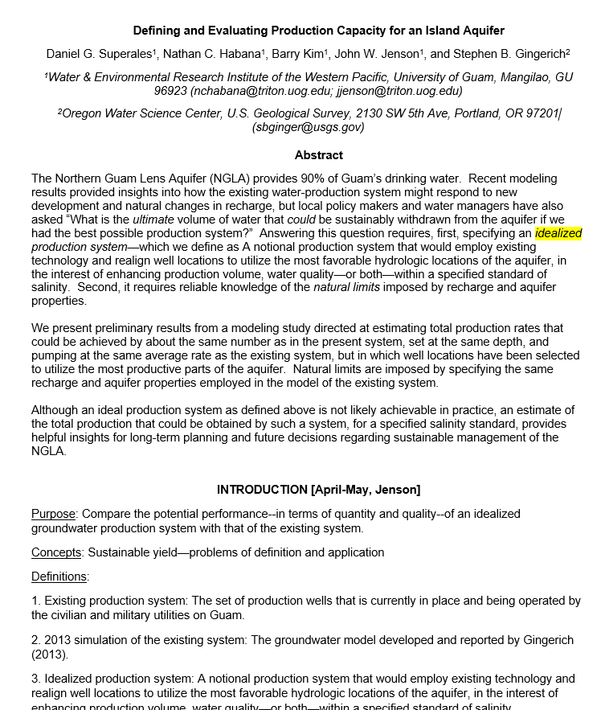

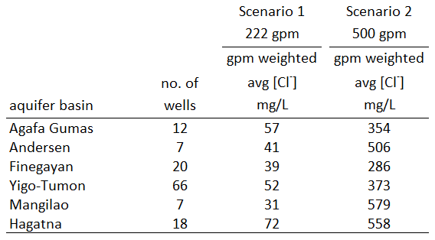
Phase 4 – For Publication and Nashville (NGWA)

Slide 16
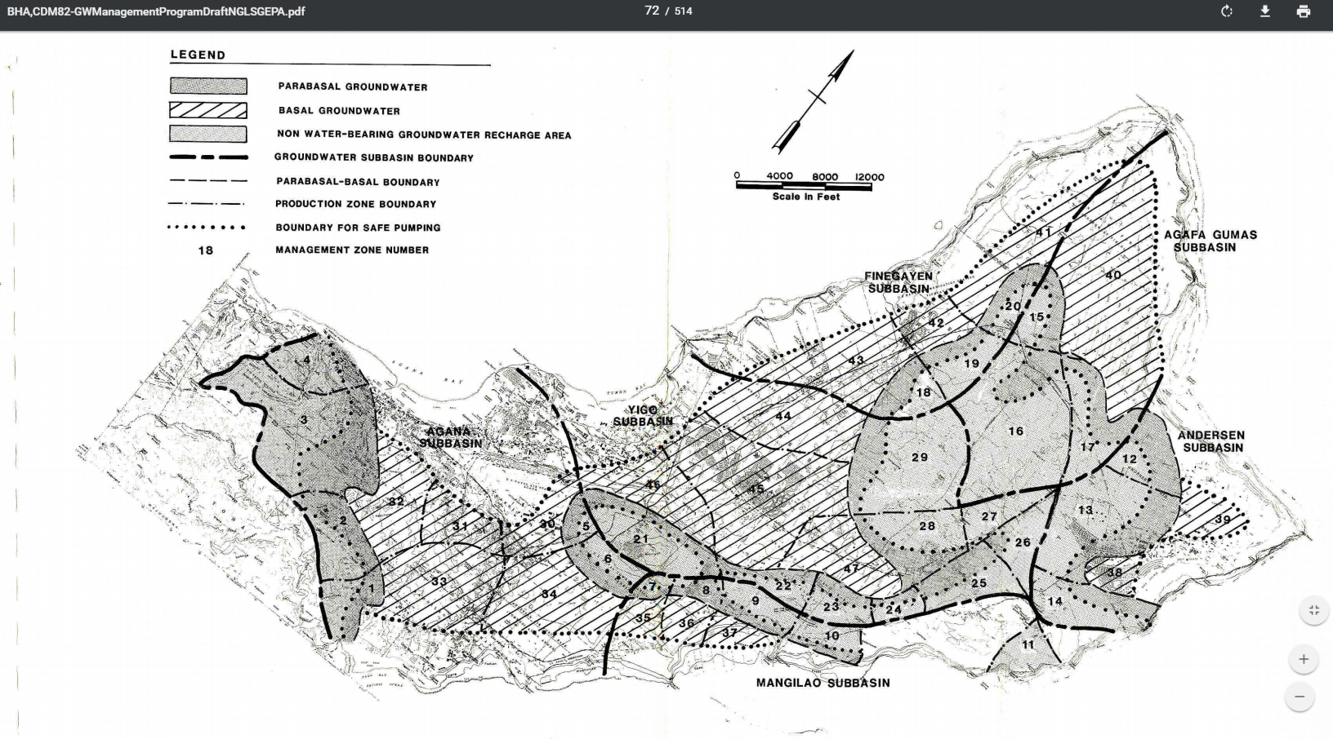

Slide 17
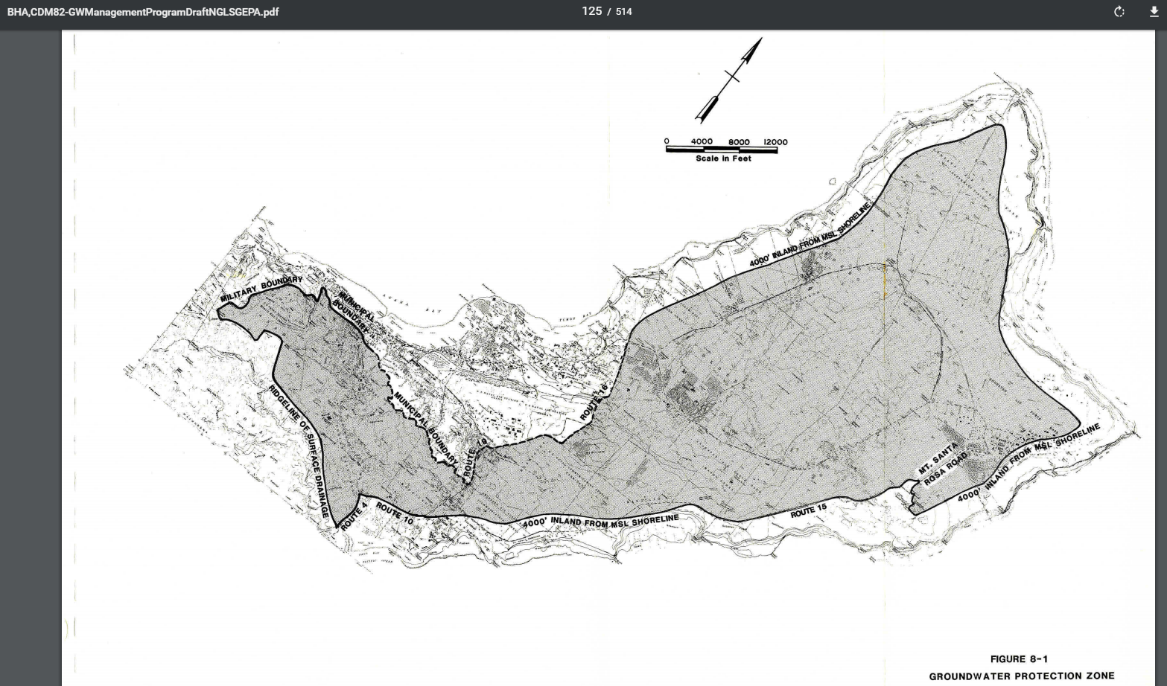

Slide 18
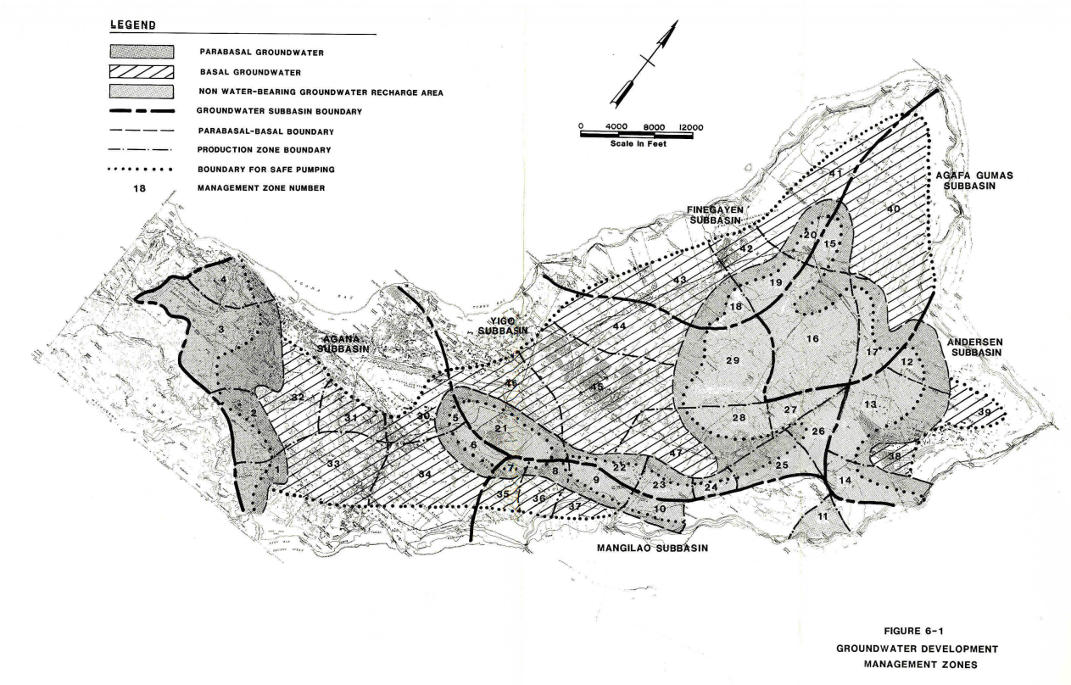

Slide 19
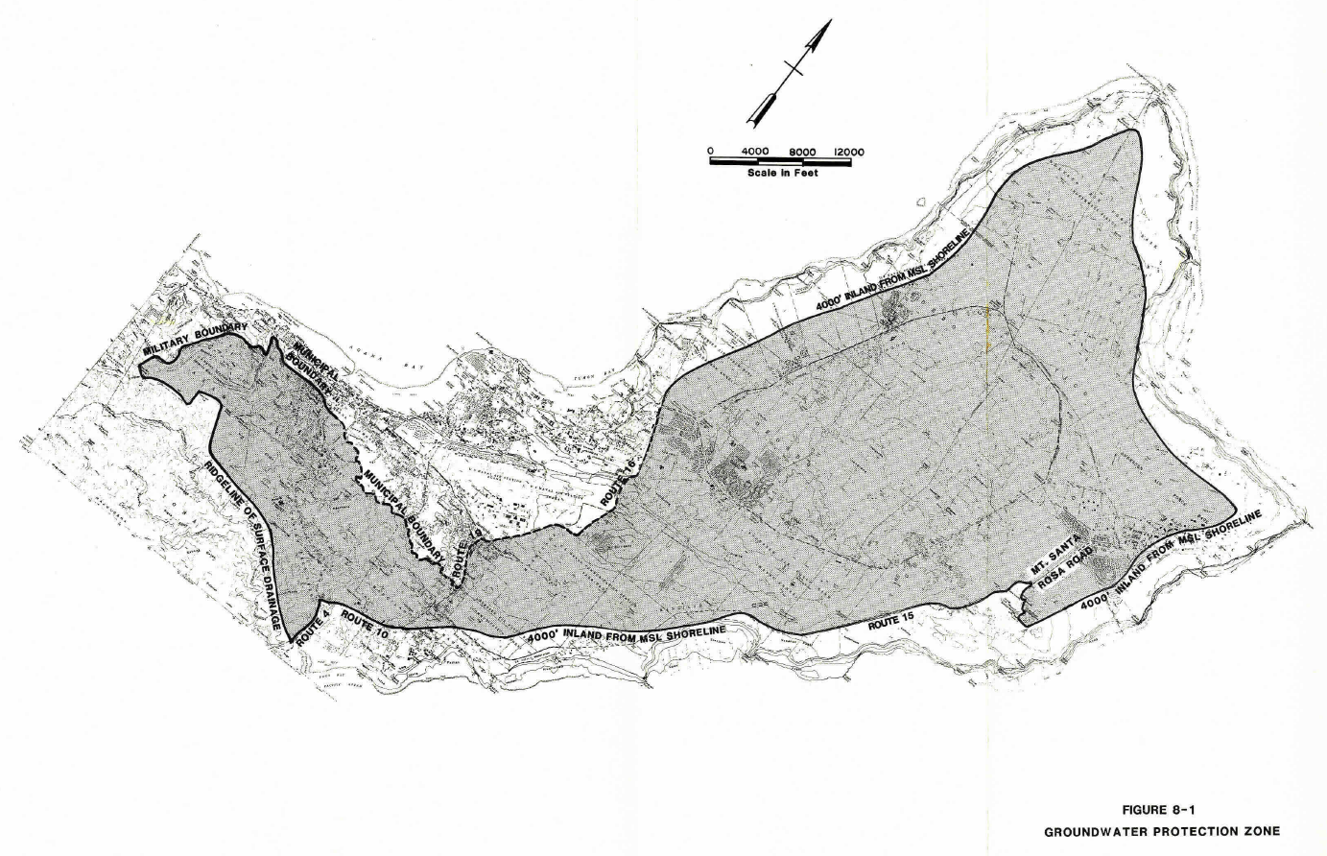

Slide 20
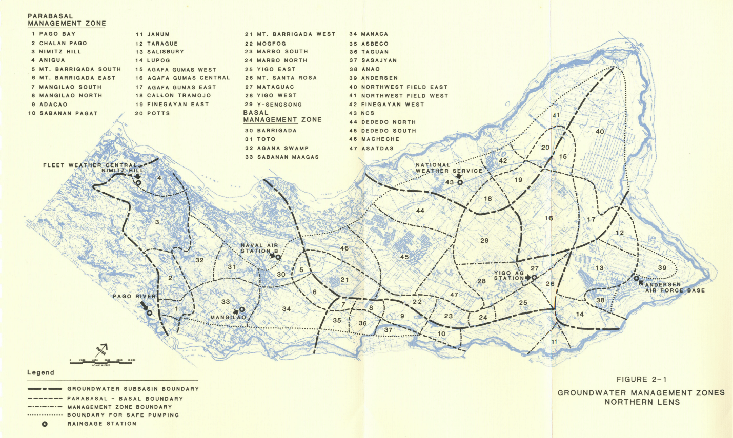

Slide 21
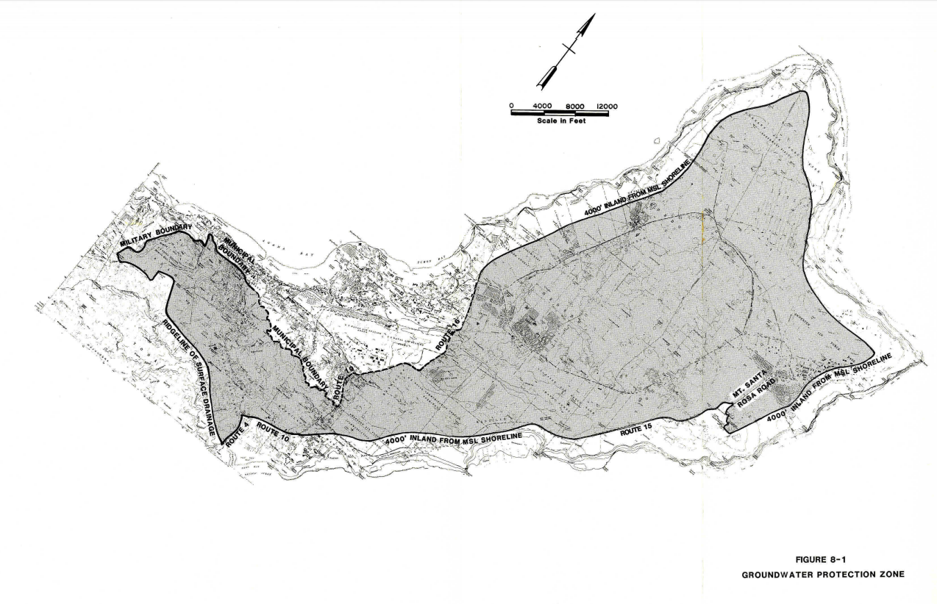

Slide 22
