Slide 1
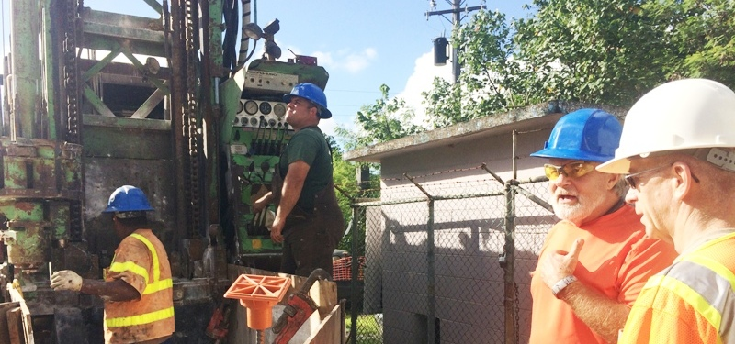
WERI Professional Workshop | Northern Guam Lens Aquifer weri.uog.edu | guamhydrologicsurvey.uog.edu
GHS website – borehole and chloride database
Dr. N.C. Habana and Dr. J.W. Jenson
Water Environmental Research Institute of the Western Pacific
University of Guam

Slide 3
Geology and groundwater study
  Distribution of earth materials – outcrops, extent, changes
  Porosity and hydraulic conductivity
  Map useful hydrogeology of gathered and organized information
Detailed Exploration
  Existing maps – satellite/aerial imagery(photos), geologic maps
  Available literature
  Form a network of partners and experts
  Borehole logs, existing wells, test bore, fracture analysis, surface analysis
  Field check – “walking survey” of area(s)
  Pump test sites of interest
Suitability of site(s)
  Evaluate surroundings and level of development
  Identify sources of contaminant, polluted/contaminated areas
Scientific Reports
  Goal, Purpose, Objectives | Scope, Limitations, and Delimitations
  Selection – data, methods, field investigation, observations
  Databased analysis - statistics, patterns, trends, groups…
  Interpretation of results
  Recommendations (proper, practical, sustainable, and optimum) for policies, management, and development

Slide 4
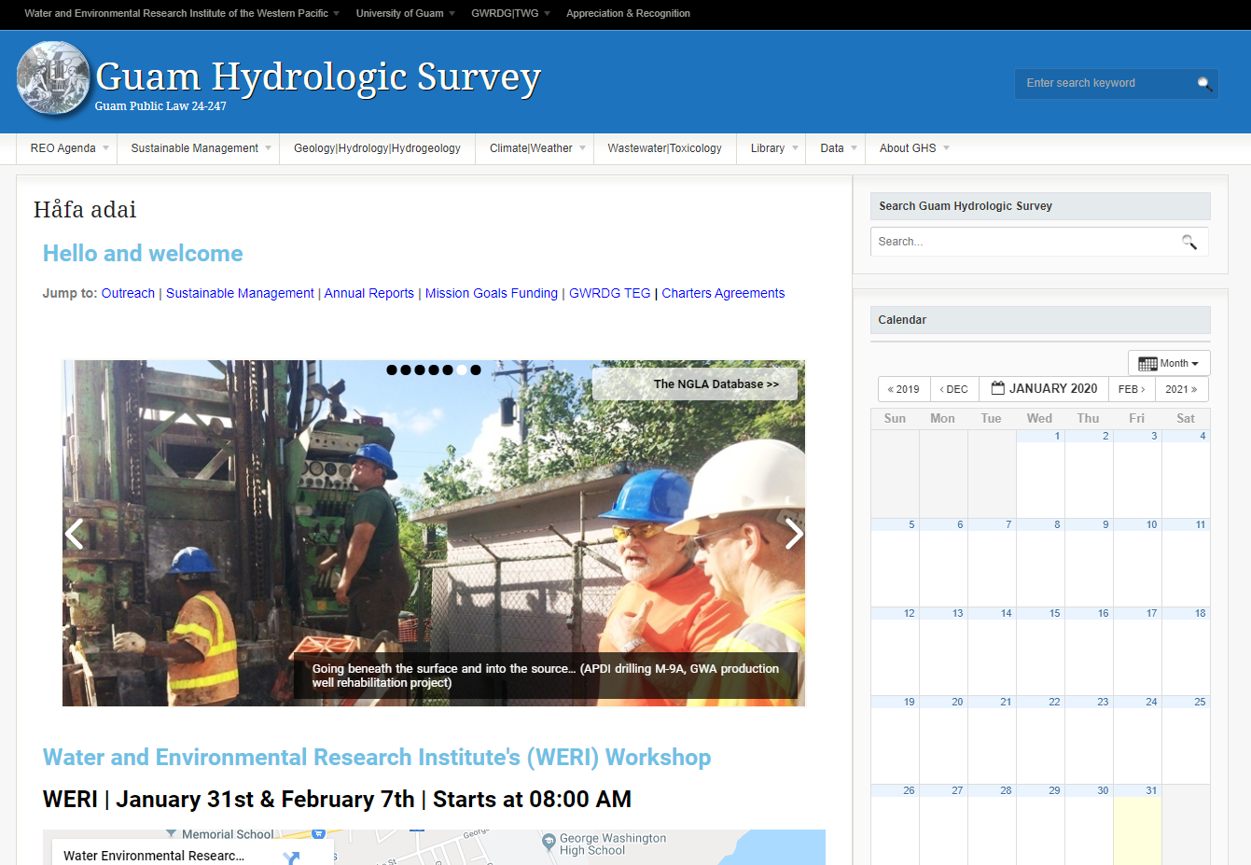

Slide 5


Slide 6
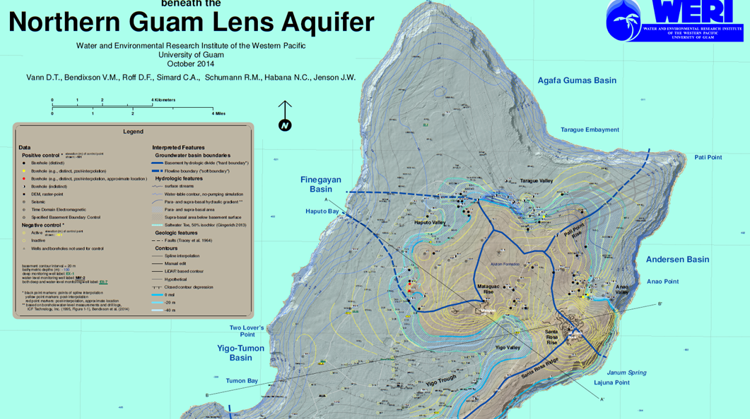
WERI Professional Workshop | Northern Guam Lens Aquifer
Basement Map: History of its development and overview of TR 142
Dr. N.C. Habana and Dr. J.W. Jenson
Water Environmental Research Institute of the Western Pacific
University of Guam

Slide 7
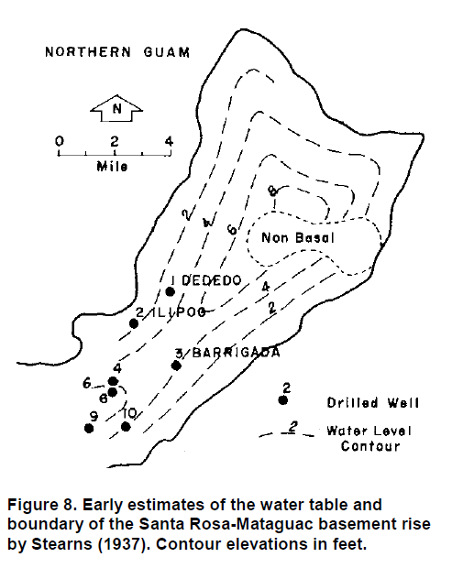

Slide 8
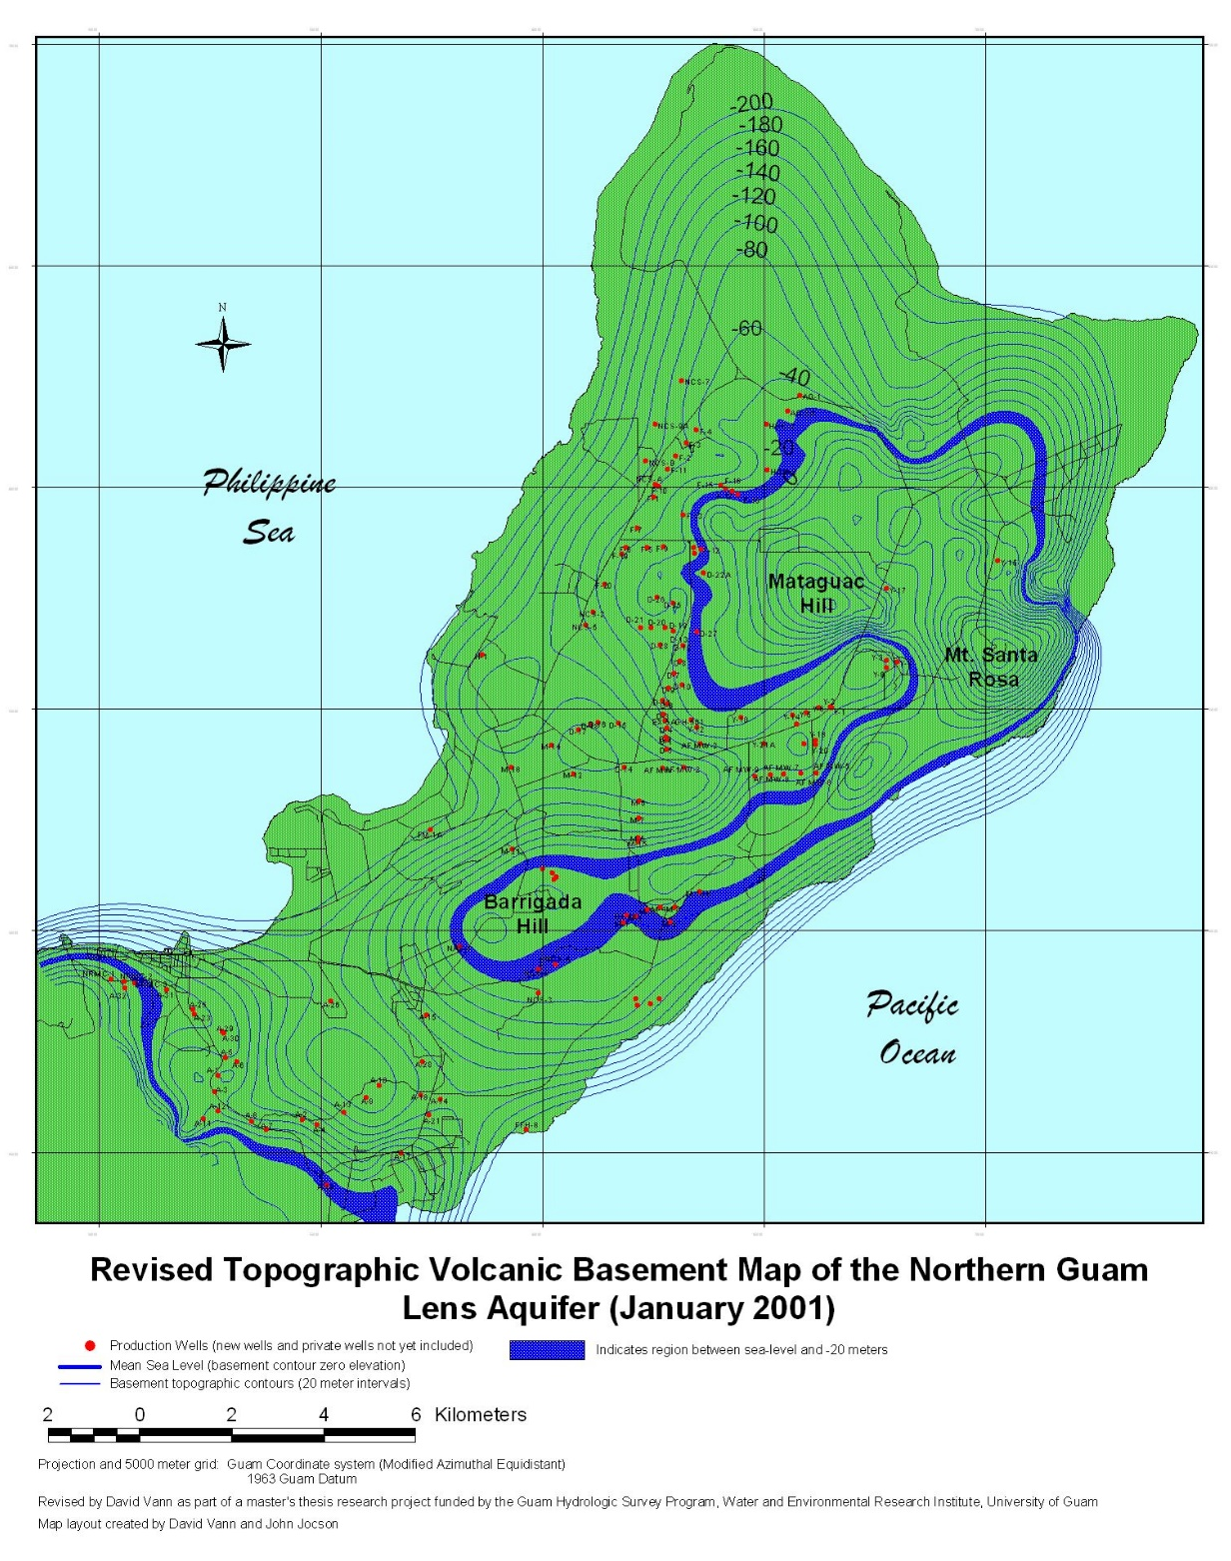
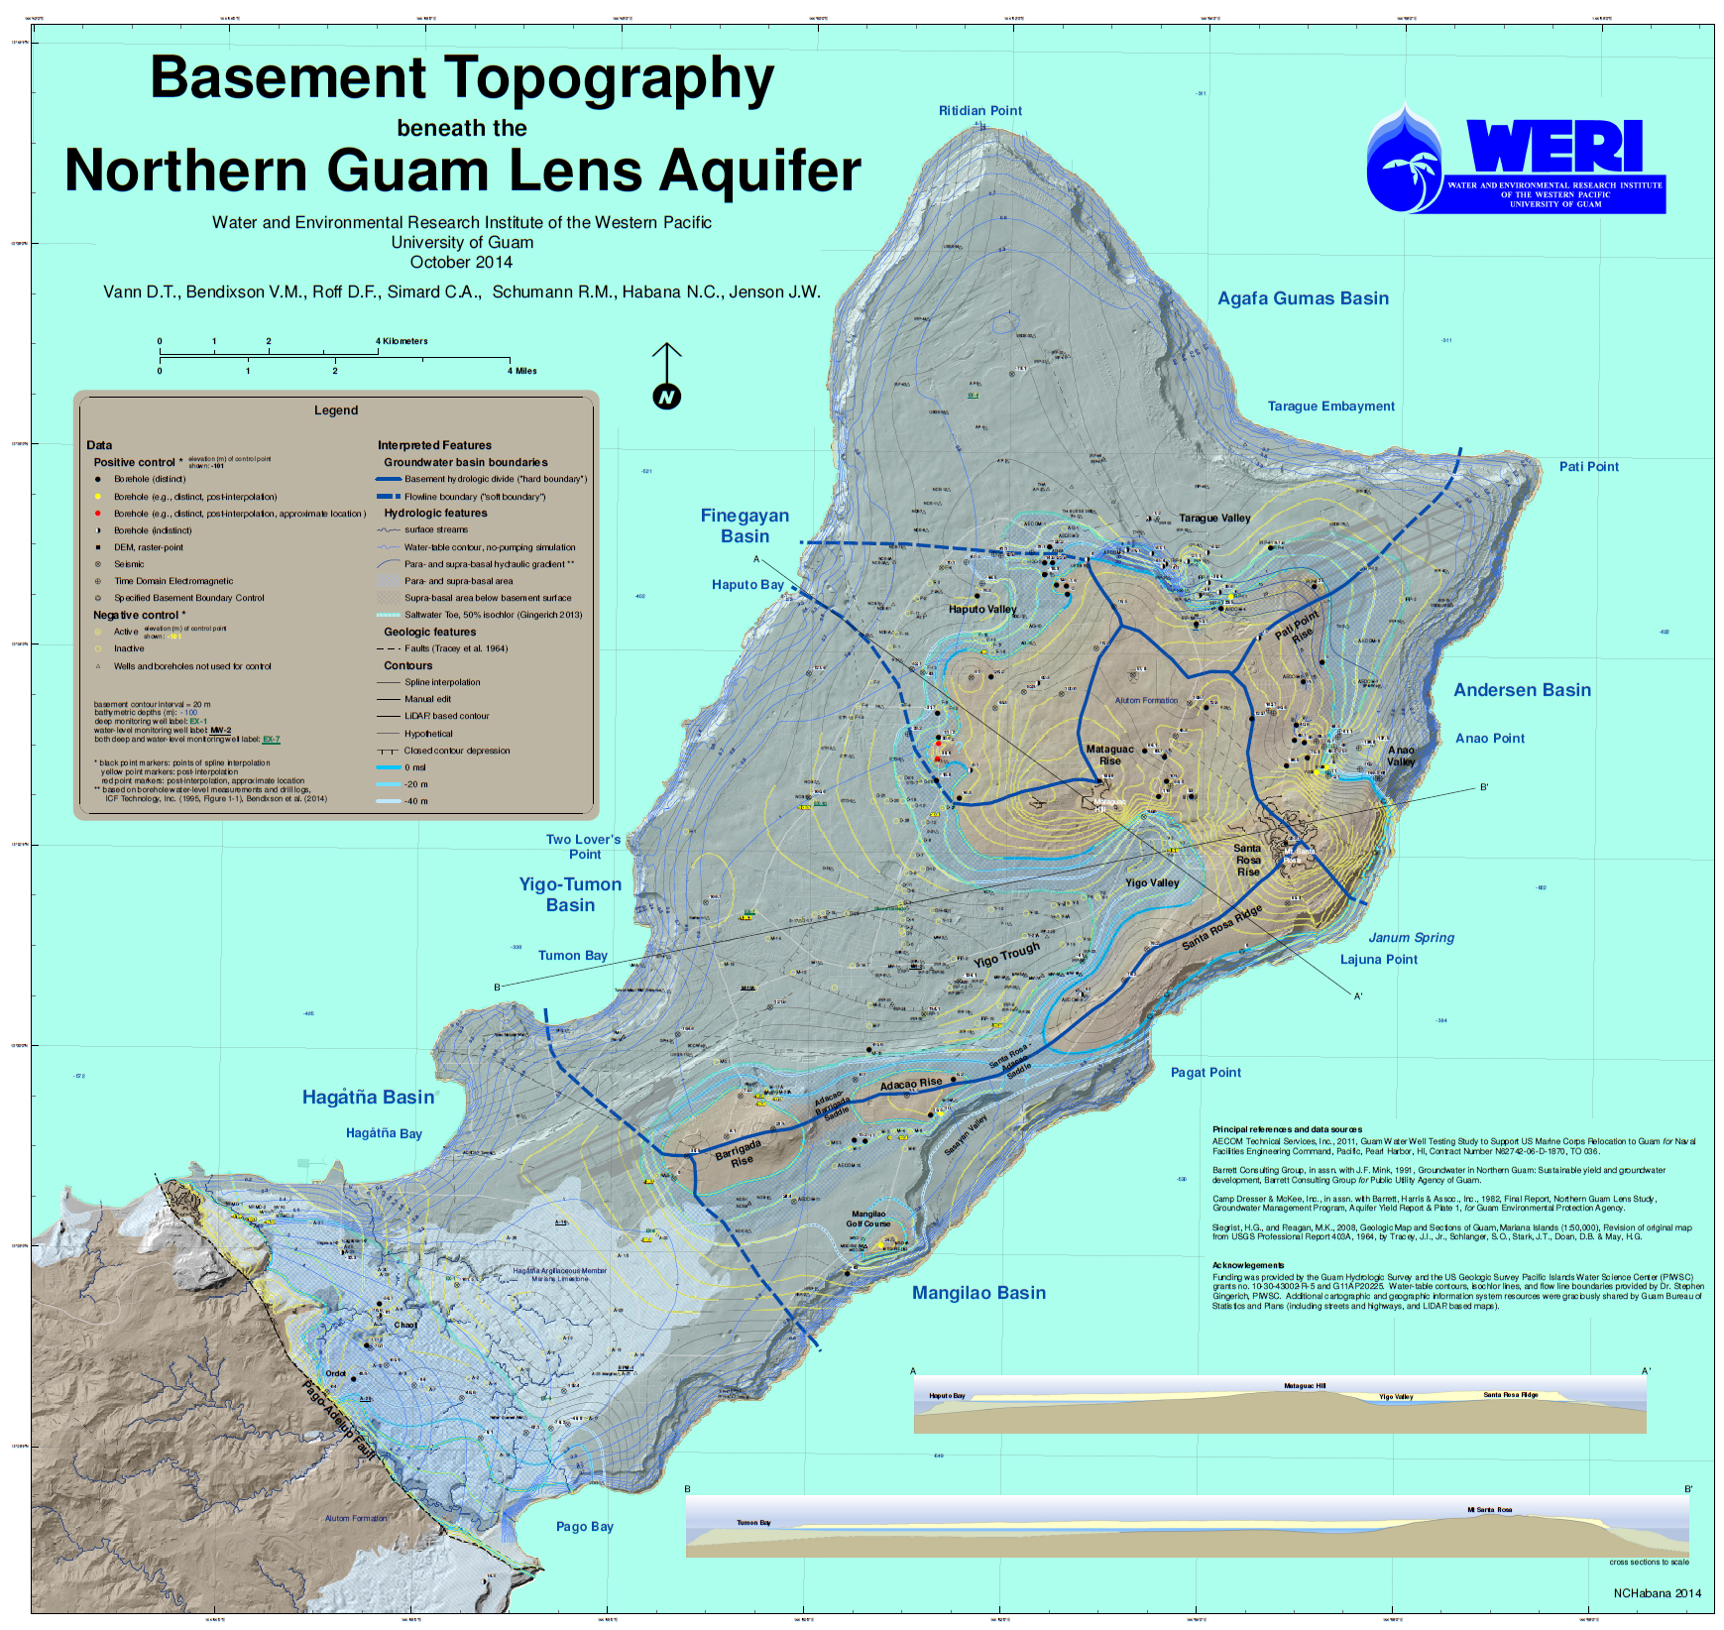

Slide 9


Slide 10
2016 WERI Professional Workshops on the Northern Guam Lens Aquifer
Basement Map: Organization and content of the map, each basin
Dr. N.C. Habana and Dr. J.W. Jenson
Water Environmental Research Institute of the Western Pacific
University of Guam

Slide 12
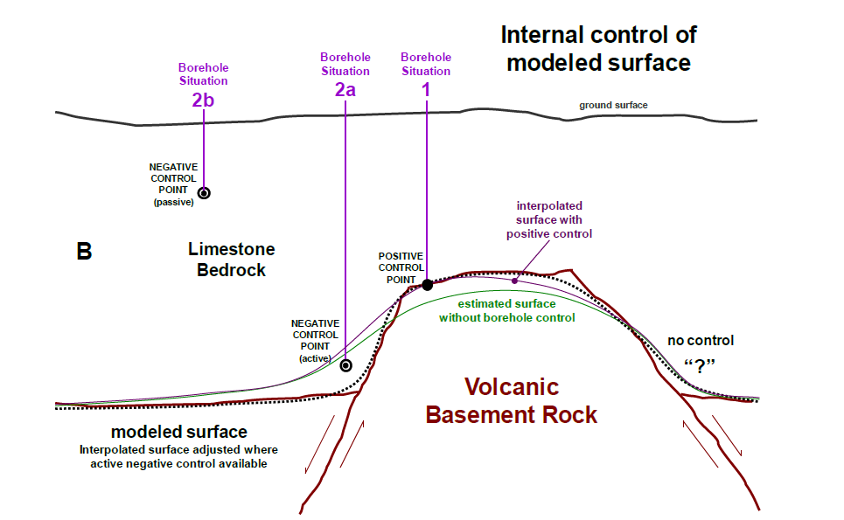
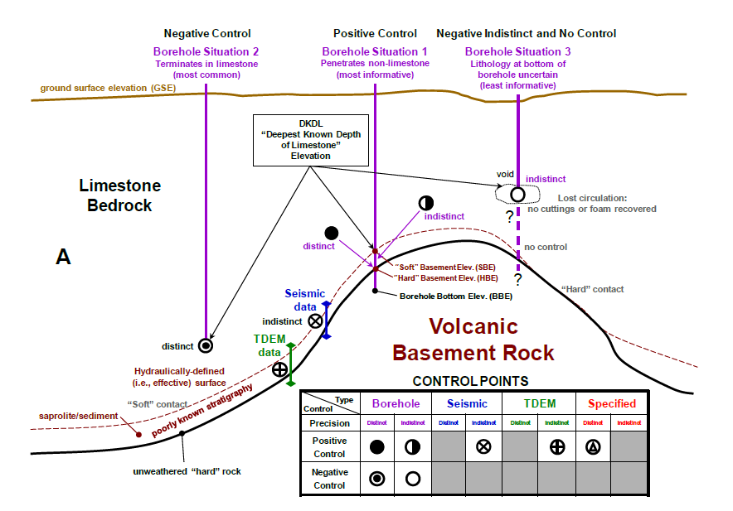

Slide 13
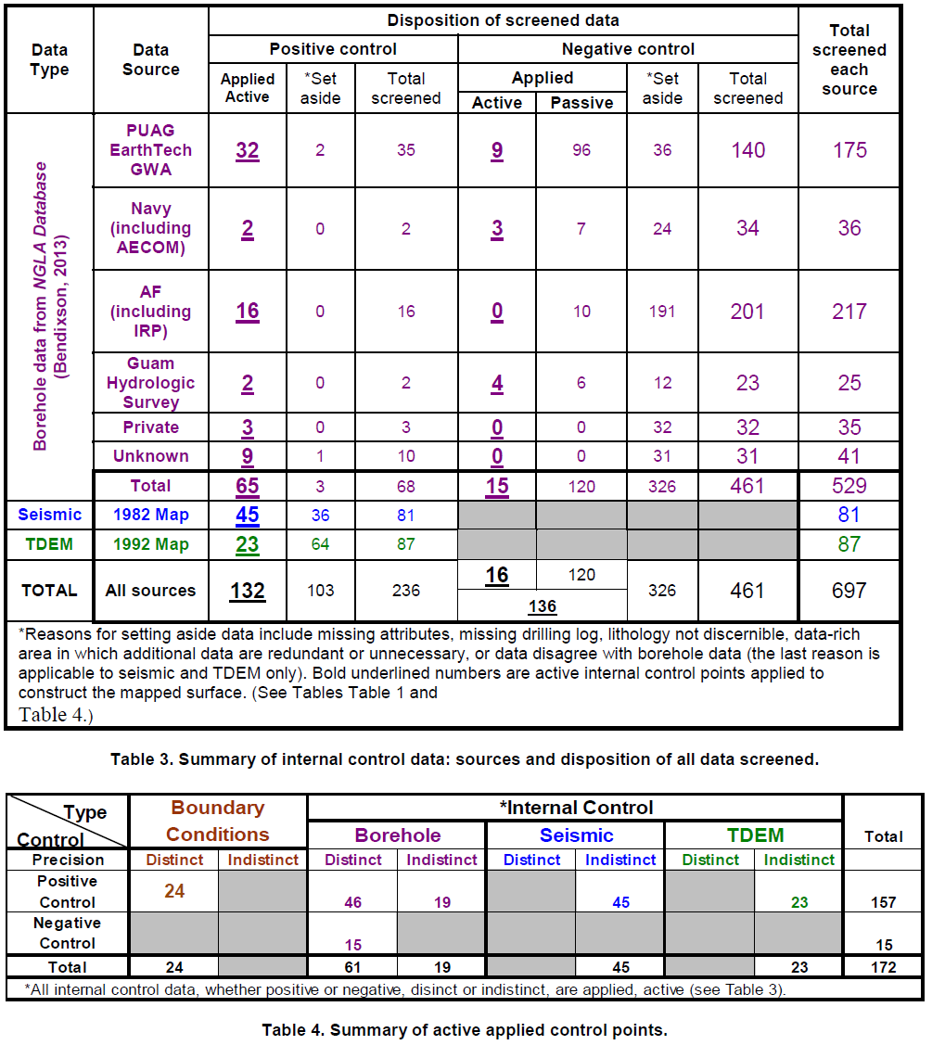

Slide 14
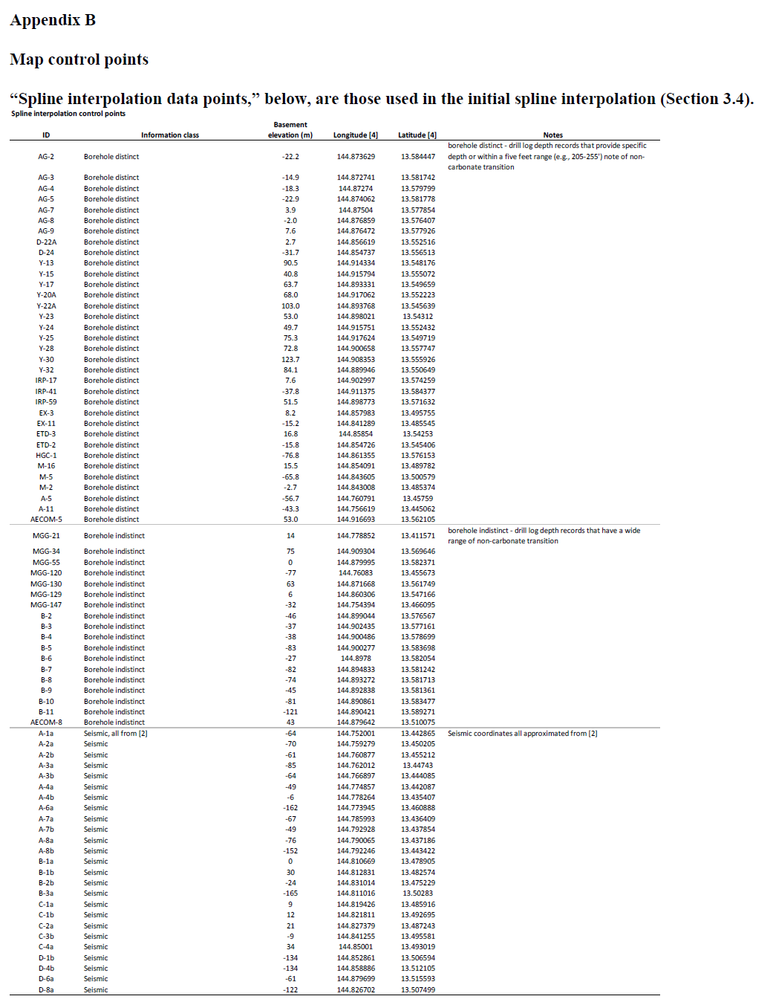
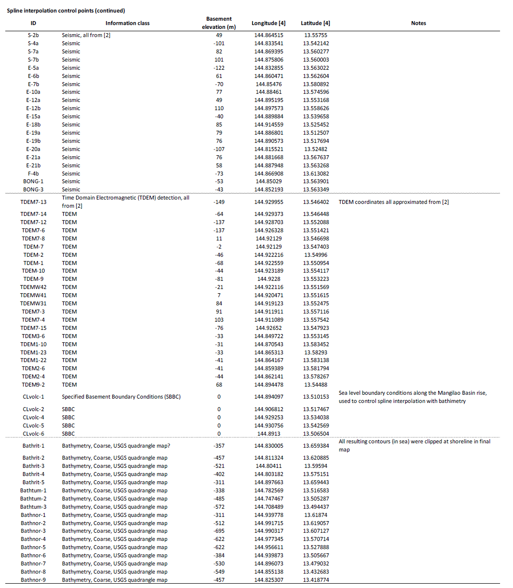

Slide 16
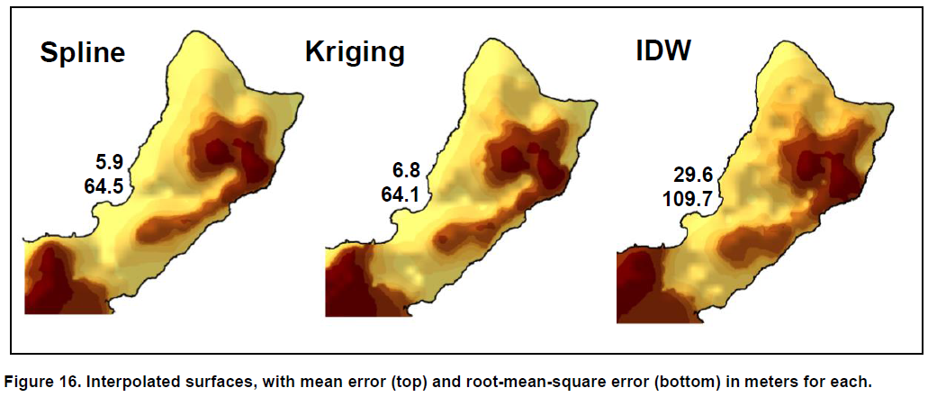
Inverse Distance Weighted

Slide 17
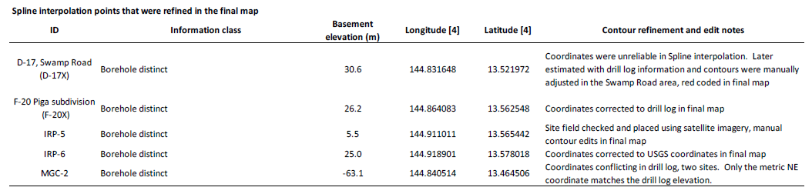
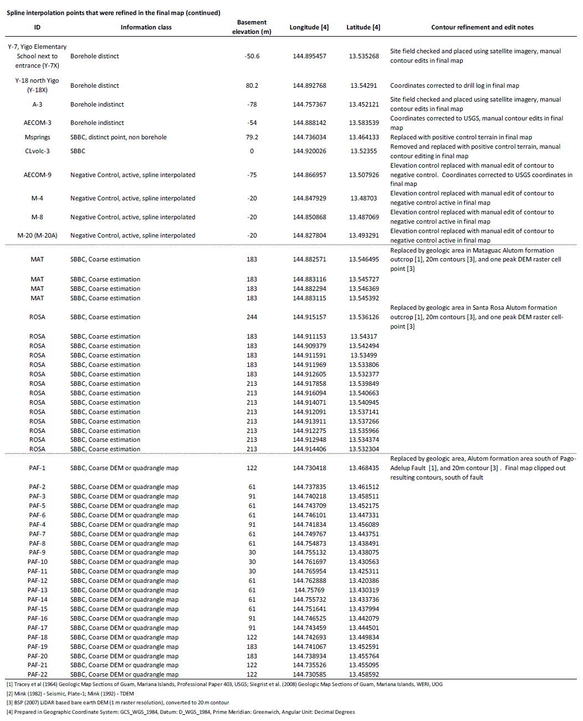

Slide 18
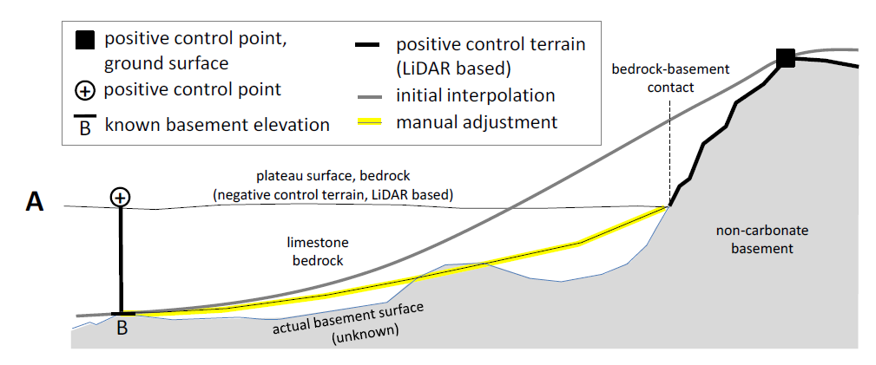
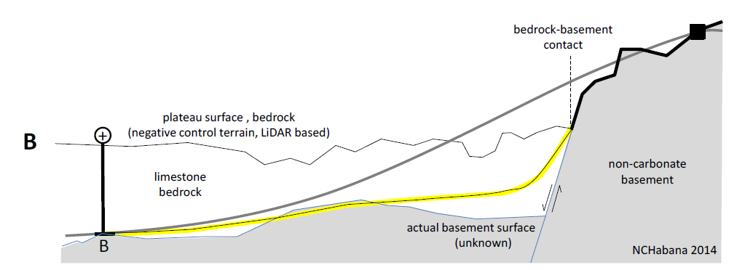

Slide 19
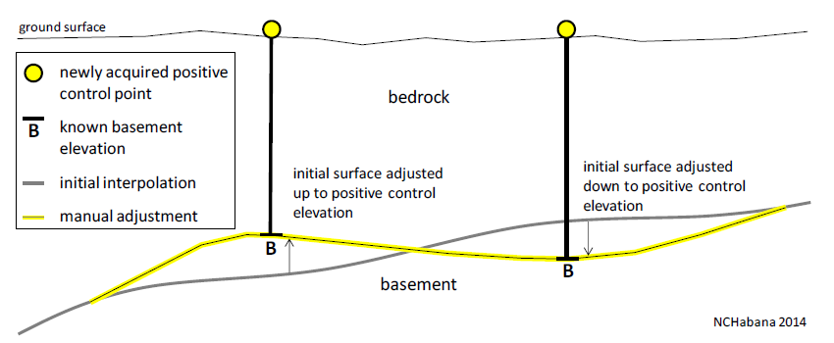
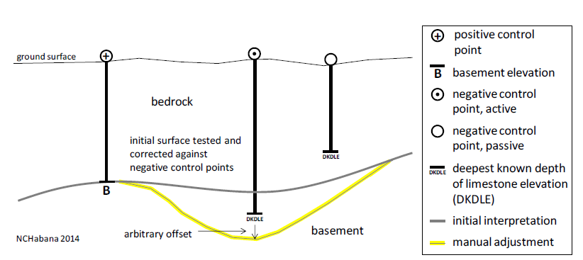

Slide 21
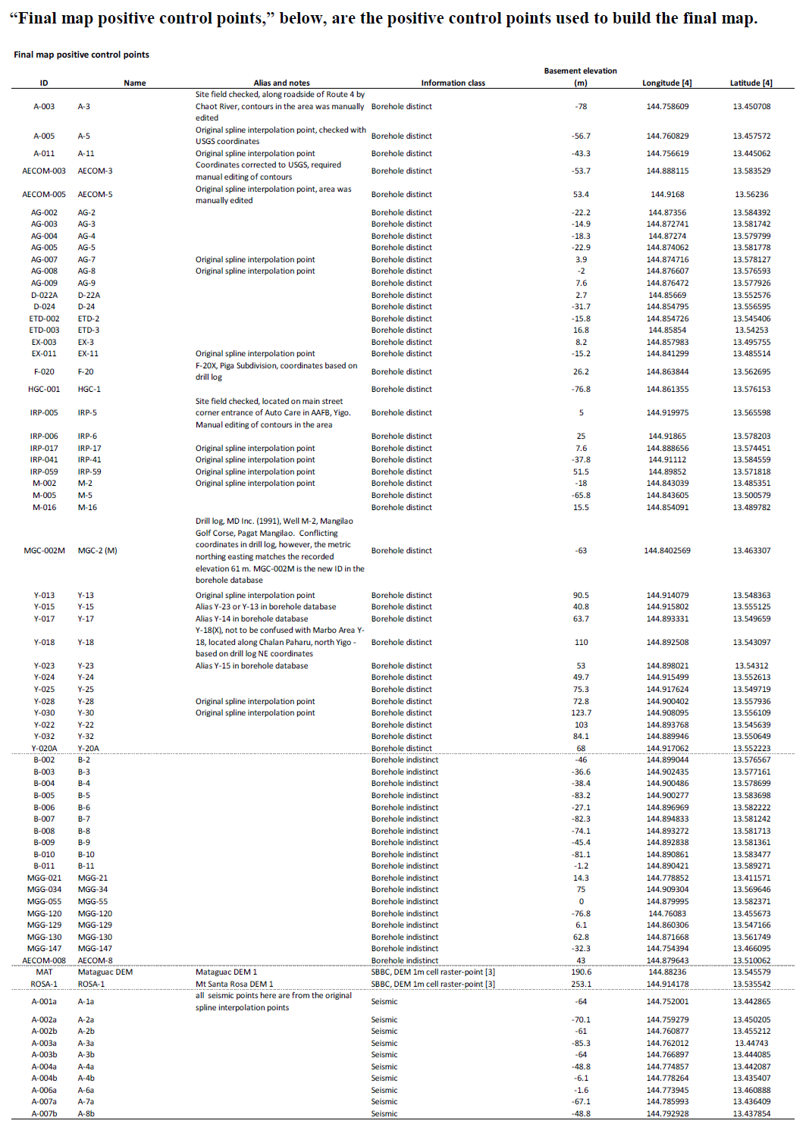
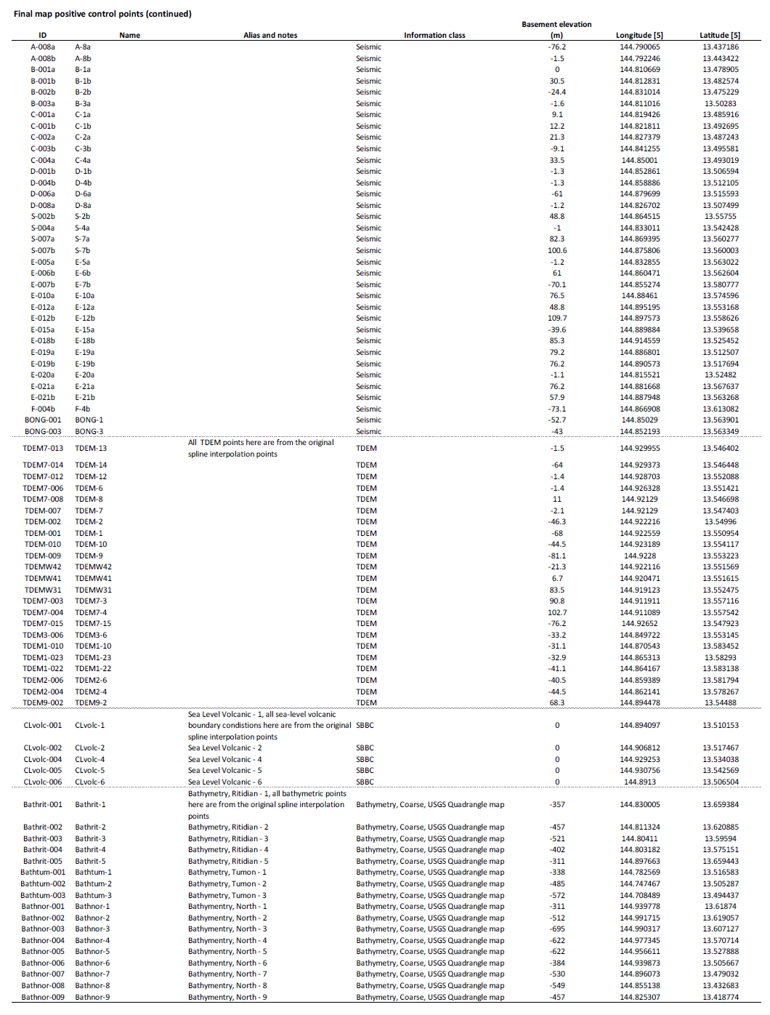
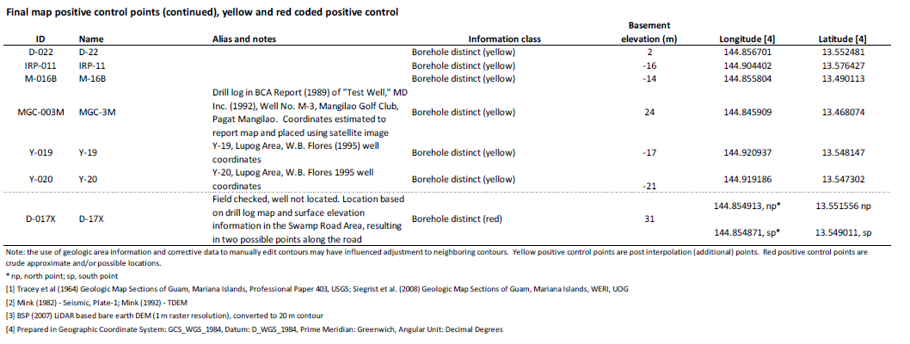

Slide 22
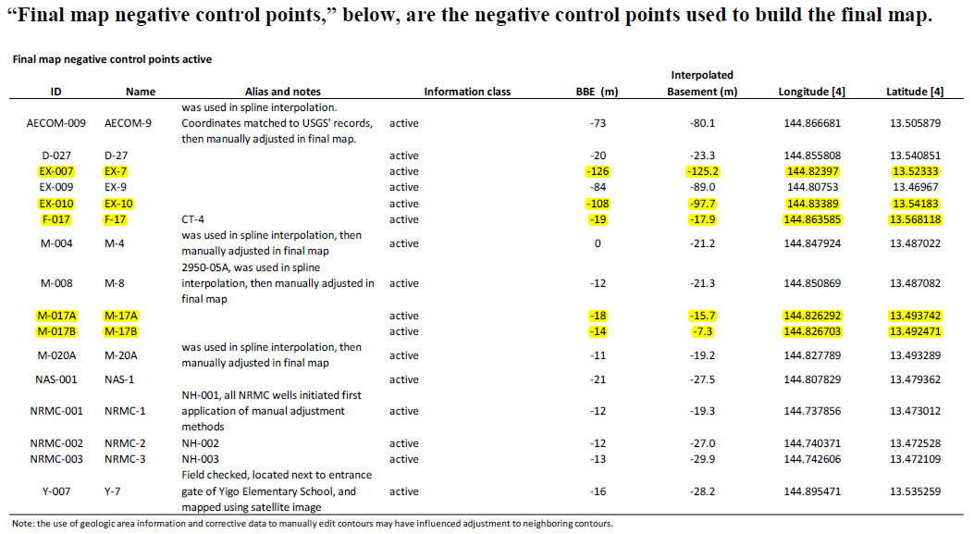

Slide 25
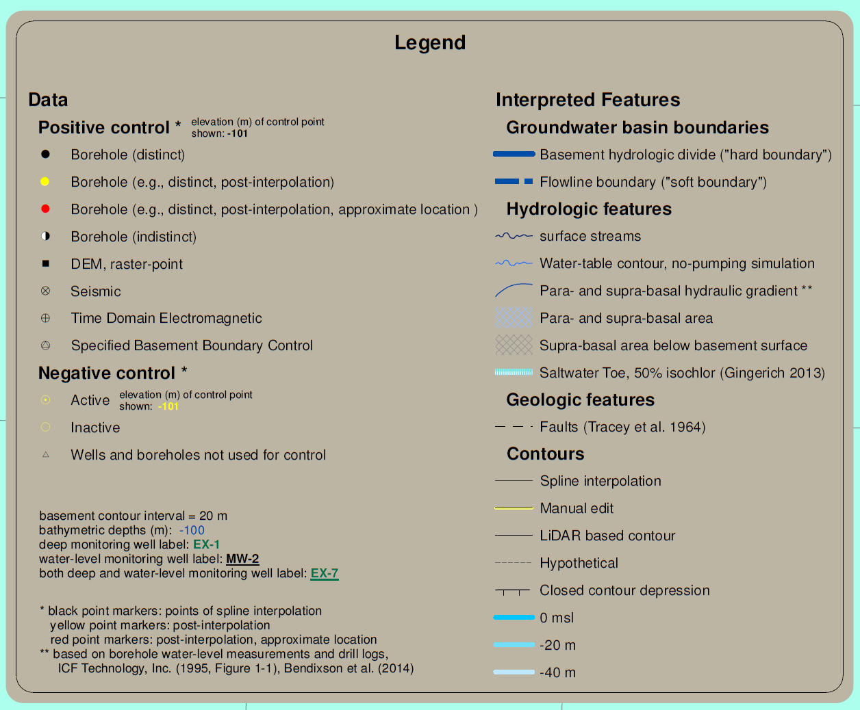
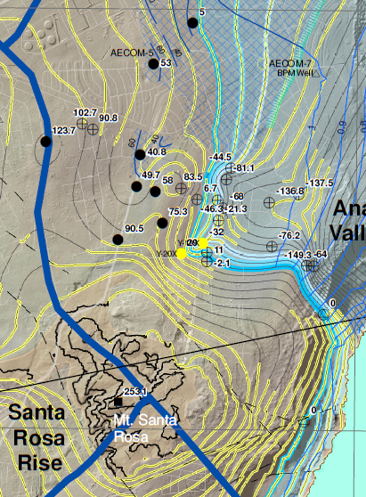
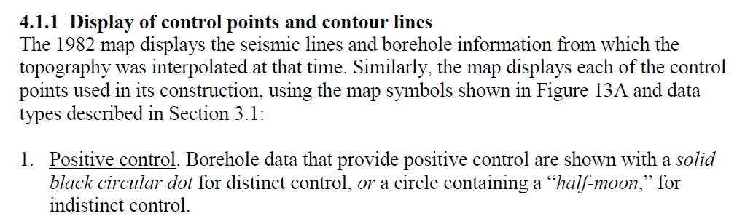

Slide 27
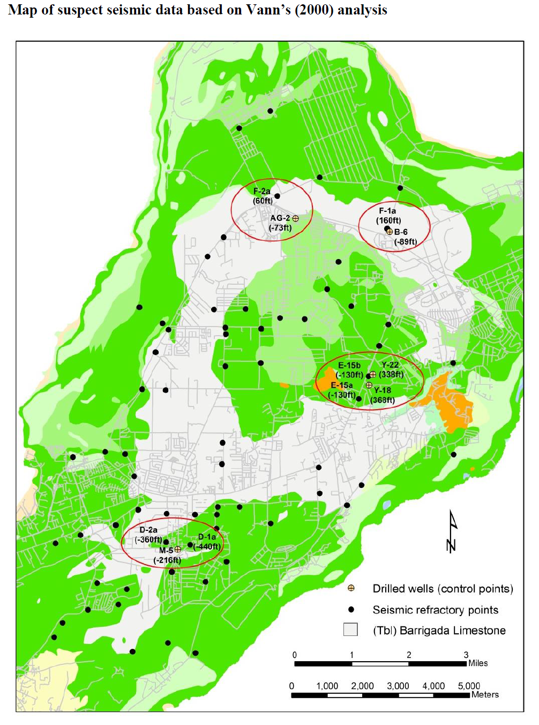
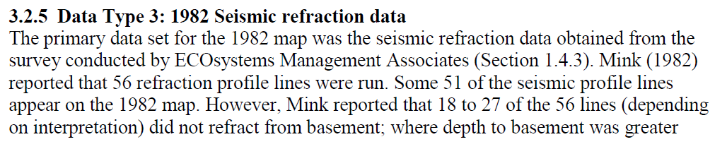
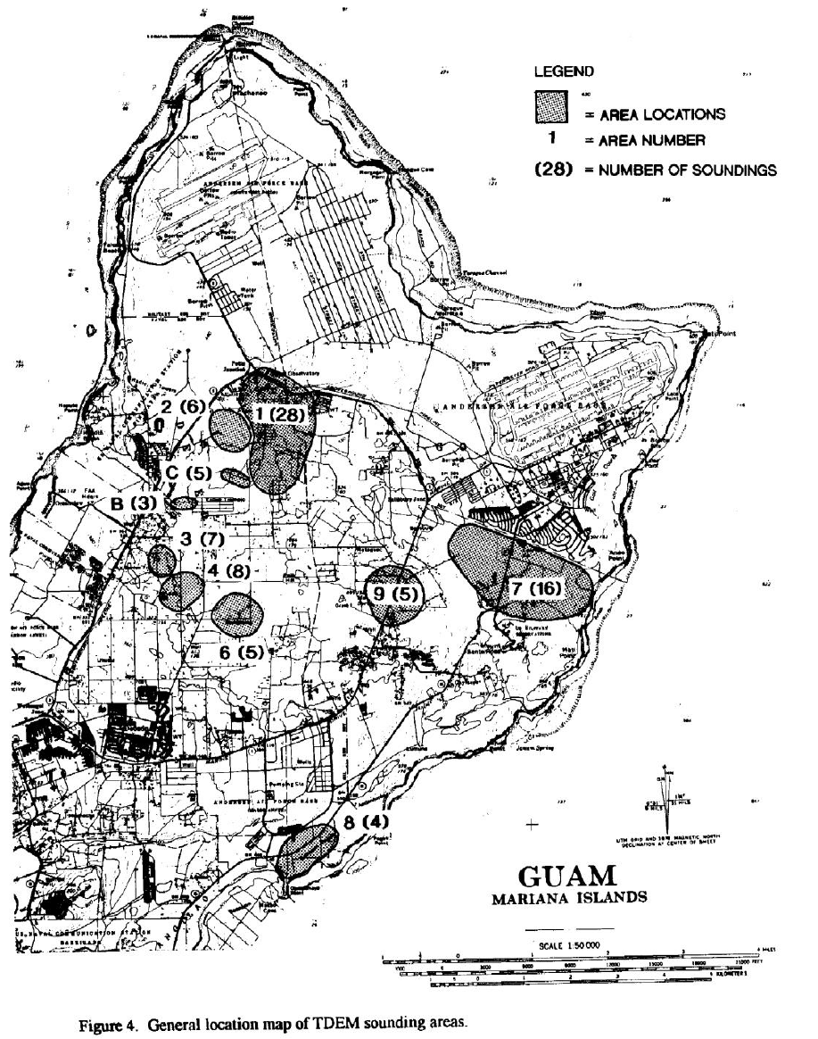
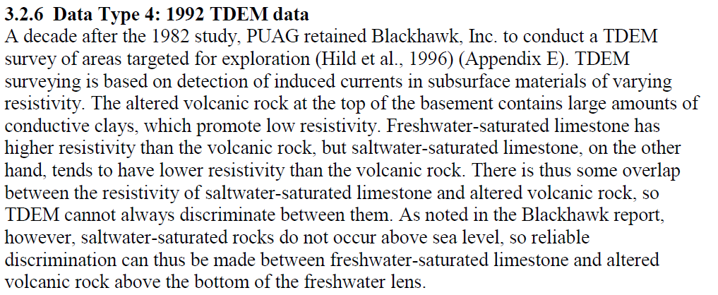

Slide 28
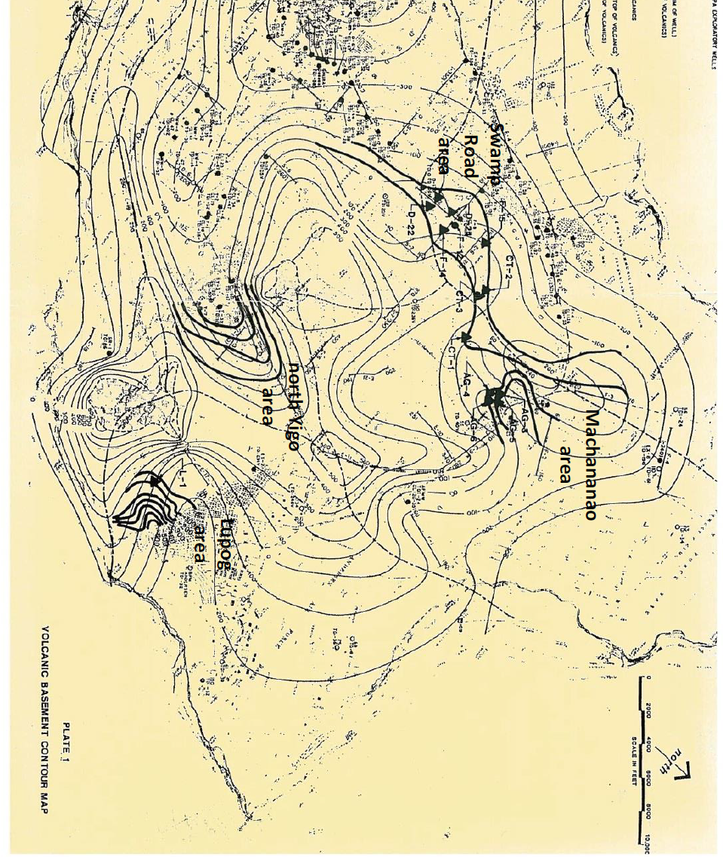

Slide 29
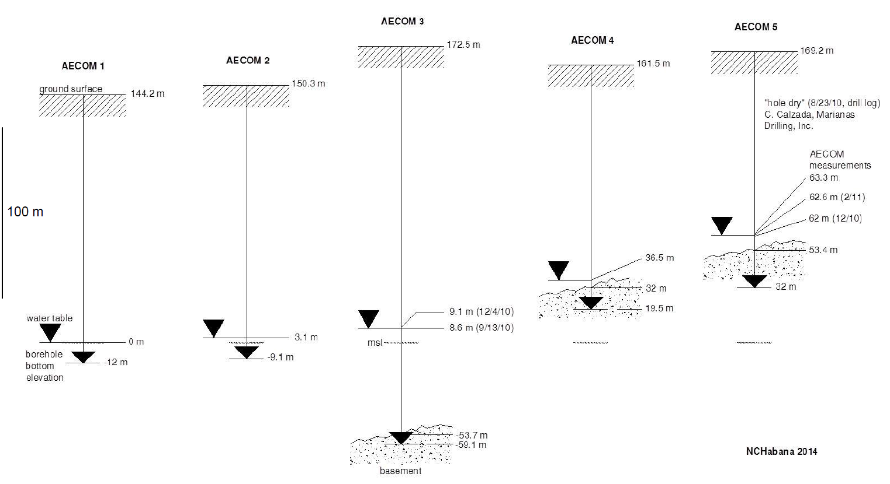

Slide 30
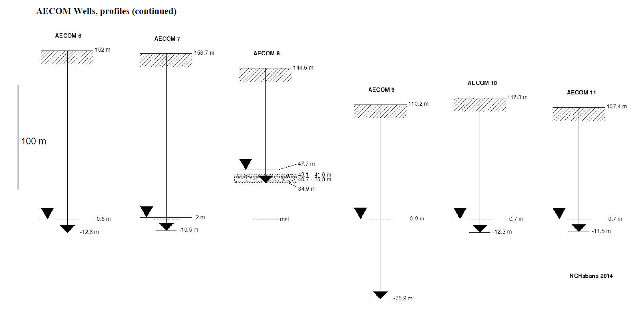

Slide 31
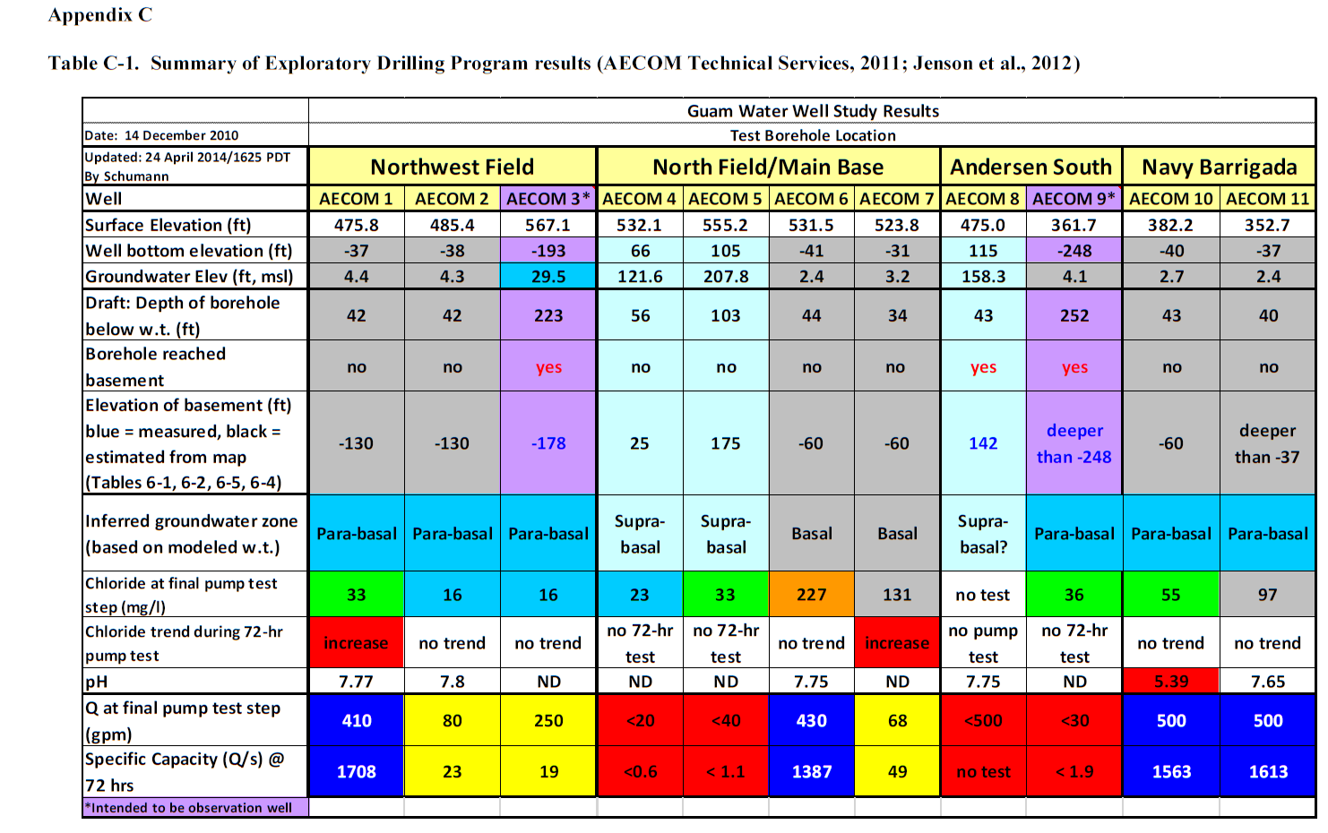

Slide 32
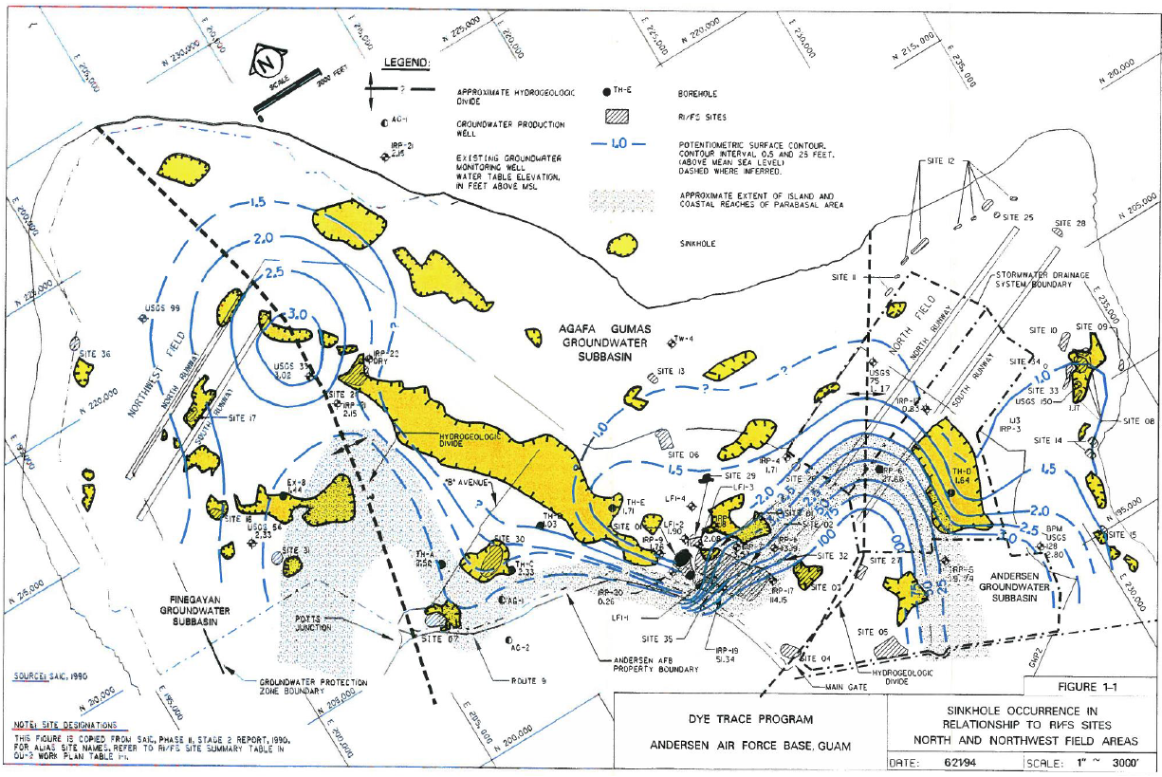

Slide 34
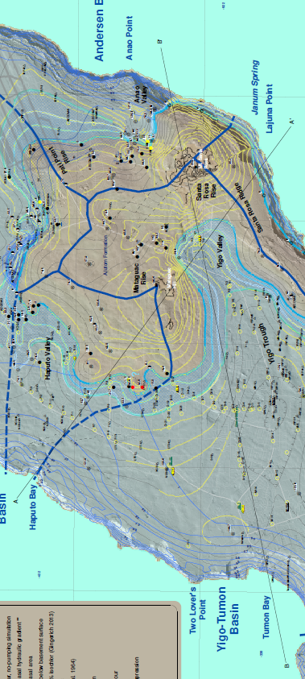
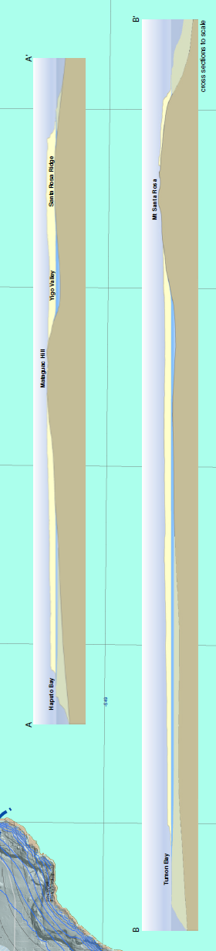

Slide 35
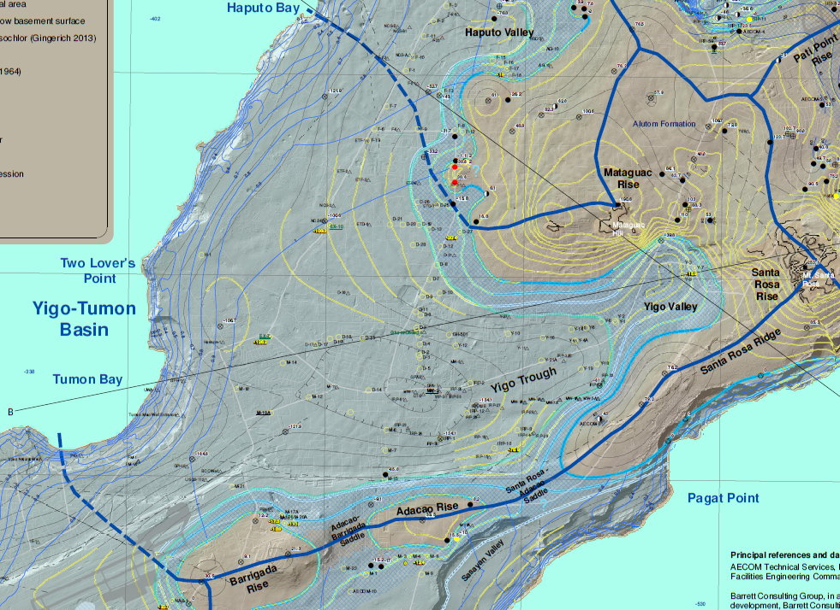
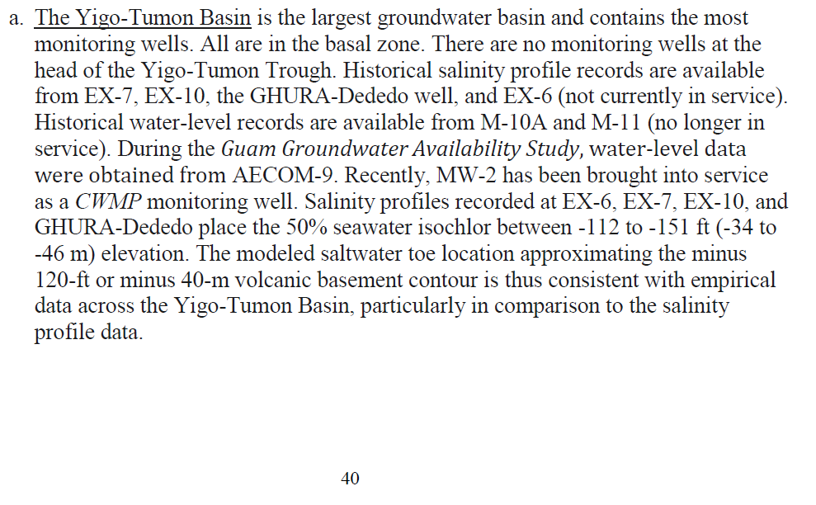

Slide 36
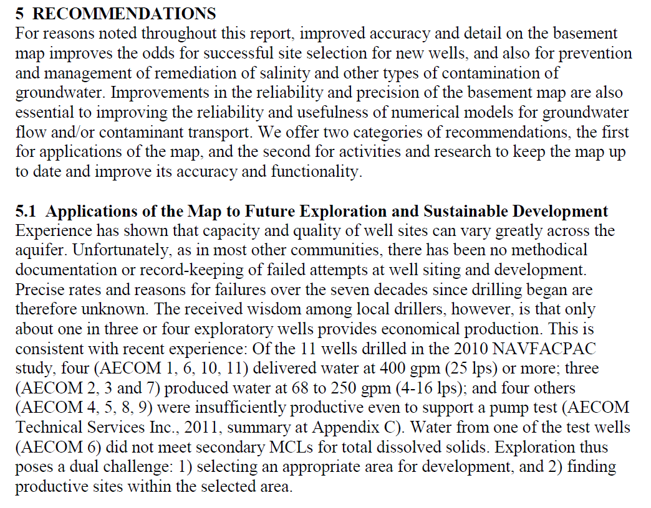

Slide 37
