Slide 1
Time | min | Topic | Instructors
08:00 | 30 | Sign-in, coffee and donuts, WERI room 105
08:30 | 15 | Welcome and workshop overview | Jenson (WERI Director)
08:45 | 45 | Climate: Rainfall and Drought | Lander
09:30 | 30 | Review of salinity basics | Production chloride update | Habana, Jenson, Aguilo
10:00 | 30 | Break
10:30 | 30 | Groundwater Modeling: The capacity of the parabasal zone | Superales, Habana, Jenson
11:00 | 30 | GIS map analyses of wells: production and salinity | Wen
11:30 | 45 | Working lunch | Q&A session: GEPA & GWA | Bearden, Kemp (Railey)
12:15 | 30 | NGLA map of wastewater vulnerabilities | Bulaklak, Habana
12:45 | 30 | PFOS investigation | Duenas, Kim
13:15 | 15 | Q&A session: all topics
13:30 | 15-30 | End of workshop | feedback forms | Jenson

Slide 2
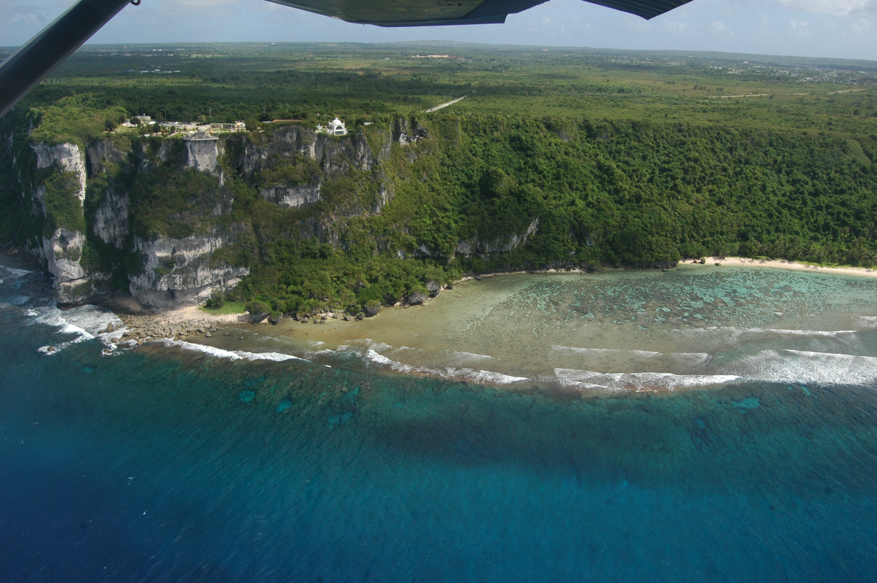

The Northern Guam
Lens Aquifer
Database & Aquifer Map
Welcome and Overview
Professional Workshop Series
Workshop #1: January 30, 2020
Water & Environmental Research Institute of the Western Pacific
University of Guam

Slide 3
WERI Workshops
January 31st, Session #1: The Northern Guam Lens Aquifer Database and Aquifer Map
Time | min | Topic | Instructors
08:00 | 30 | Sign-in, coffee and donuts, WERI room 105
08:30 | 15 | Welcome and workshop overview | Jenson (WERI Director)
08:45 | 40 | NGLA review | weri.uog.edu | guamhydrologicsurvey.uog.edu Northern Guam Lens Aquifer Database, Map, and Videos | Habana
09:30 | 30 | Sinkholes in the NGLA | Kottermair
10:00 | 30 | Break
10:30 | 60 | Crosstalk Forum: Production well rehabilitation and lessons learned | Polevich, Railey, Marquez, Shambach
11:30 | 45 | Working lunch | Q&A session: Well rehabilitation and lessons learned
12:15 | 45 | Deep Observation Wells in the Yigo-Tumon Basin: EX-7, EX-10, GD | Dougher, Habana, Jenson, Lander
13:00 | 30 | MSERP - Monitoring System Expansion and Rehabilitation Program OGAMP – One Guam Aquifer Monitoring Program | Bautista, Jenson
13:30 | 15-30 | End of session | feedback forms | Jenson
February 7th, Session #2: Salinity, Nitrogen, PFOS, Modeling Results
Time | min | Topic | Instructors
08:00 | 30 | Sign-in, coffee and donuts, WERI room 105
08:30 | 15 | Welcome and workshop overview | Jenson (WERI Director)
08:45 | 45 | Climate: Rainfall and Drought | Lander
09:30 | 30 | Review of salinity basics | Production chloride update | Habana, Jenson, Aguilo
10:00 | 30 | Break
10:30 | 30 | Groundwater Modeling: The capacity of the parabasal zone | Superales, Habana, Jenson
11:00 | 30 | GIS map analyses of wells: production and salinity | Wen
11:30 | 45 | Working lunch | Q&A session: GEPA & GWA | Bearden, Kemp (Railey)
12:15 | 30 | NGLA map of wastewater vulnerabilities | Bulaklak, Habana
12:45 | 30 | PFOS investigation | Duenas, Kim
13:15 | 15 | Q&A session: all topics
13:30 | 15-30 | End of workshop | feedback forms | Jenson

Slide 4
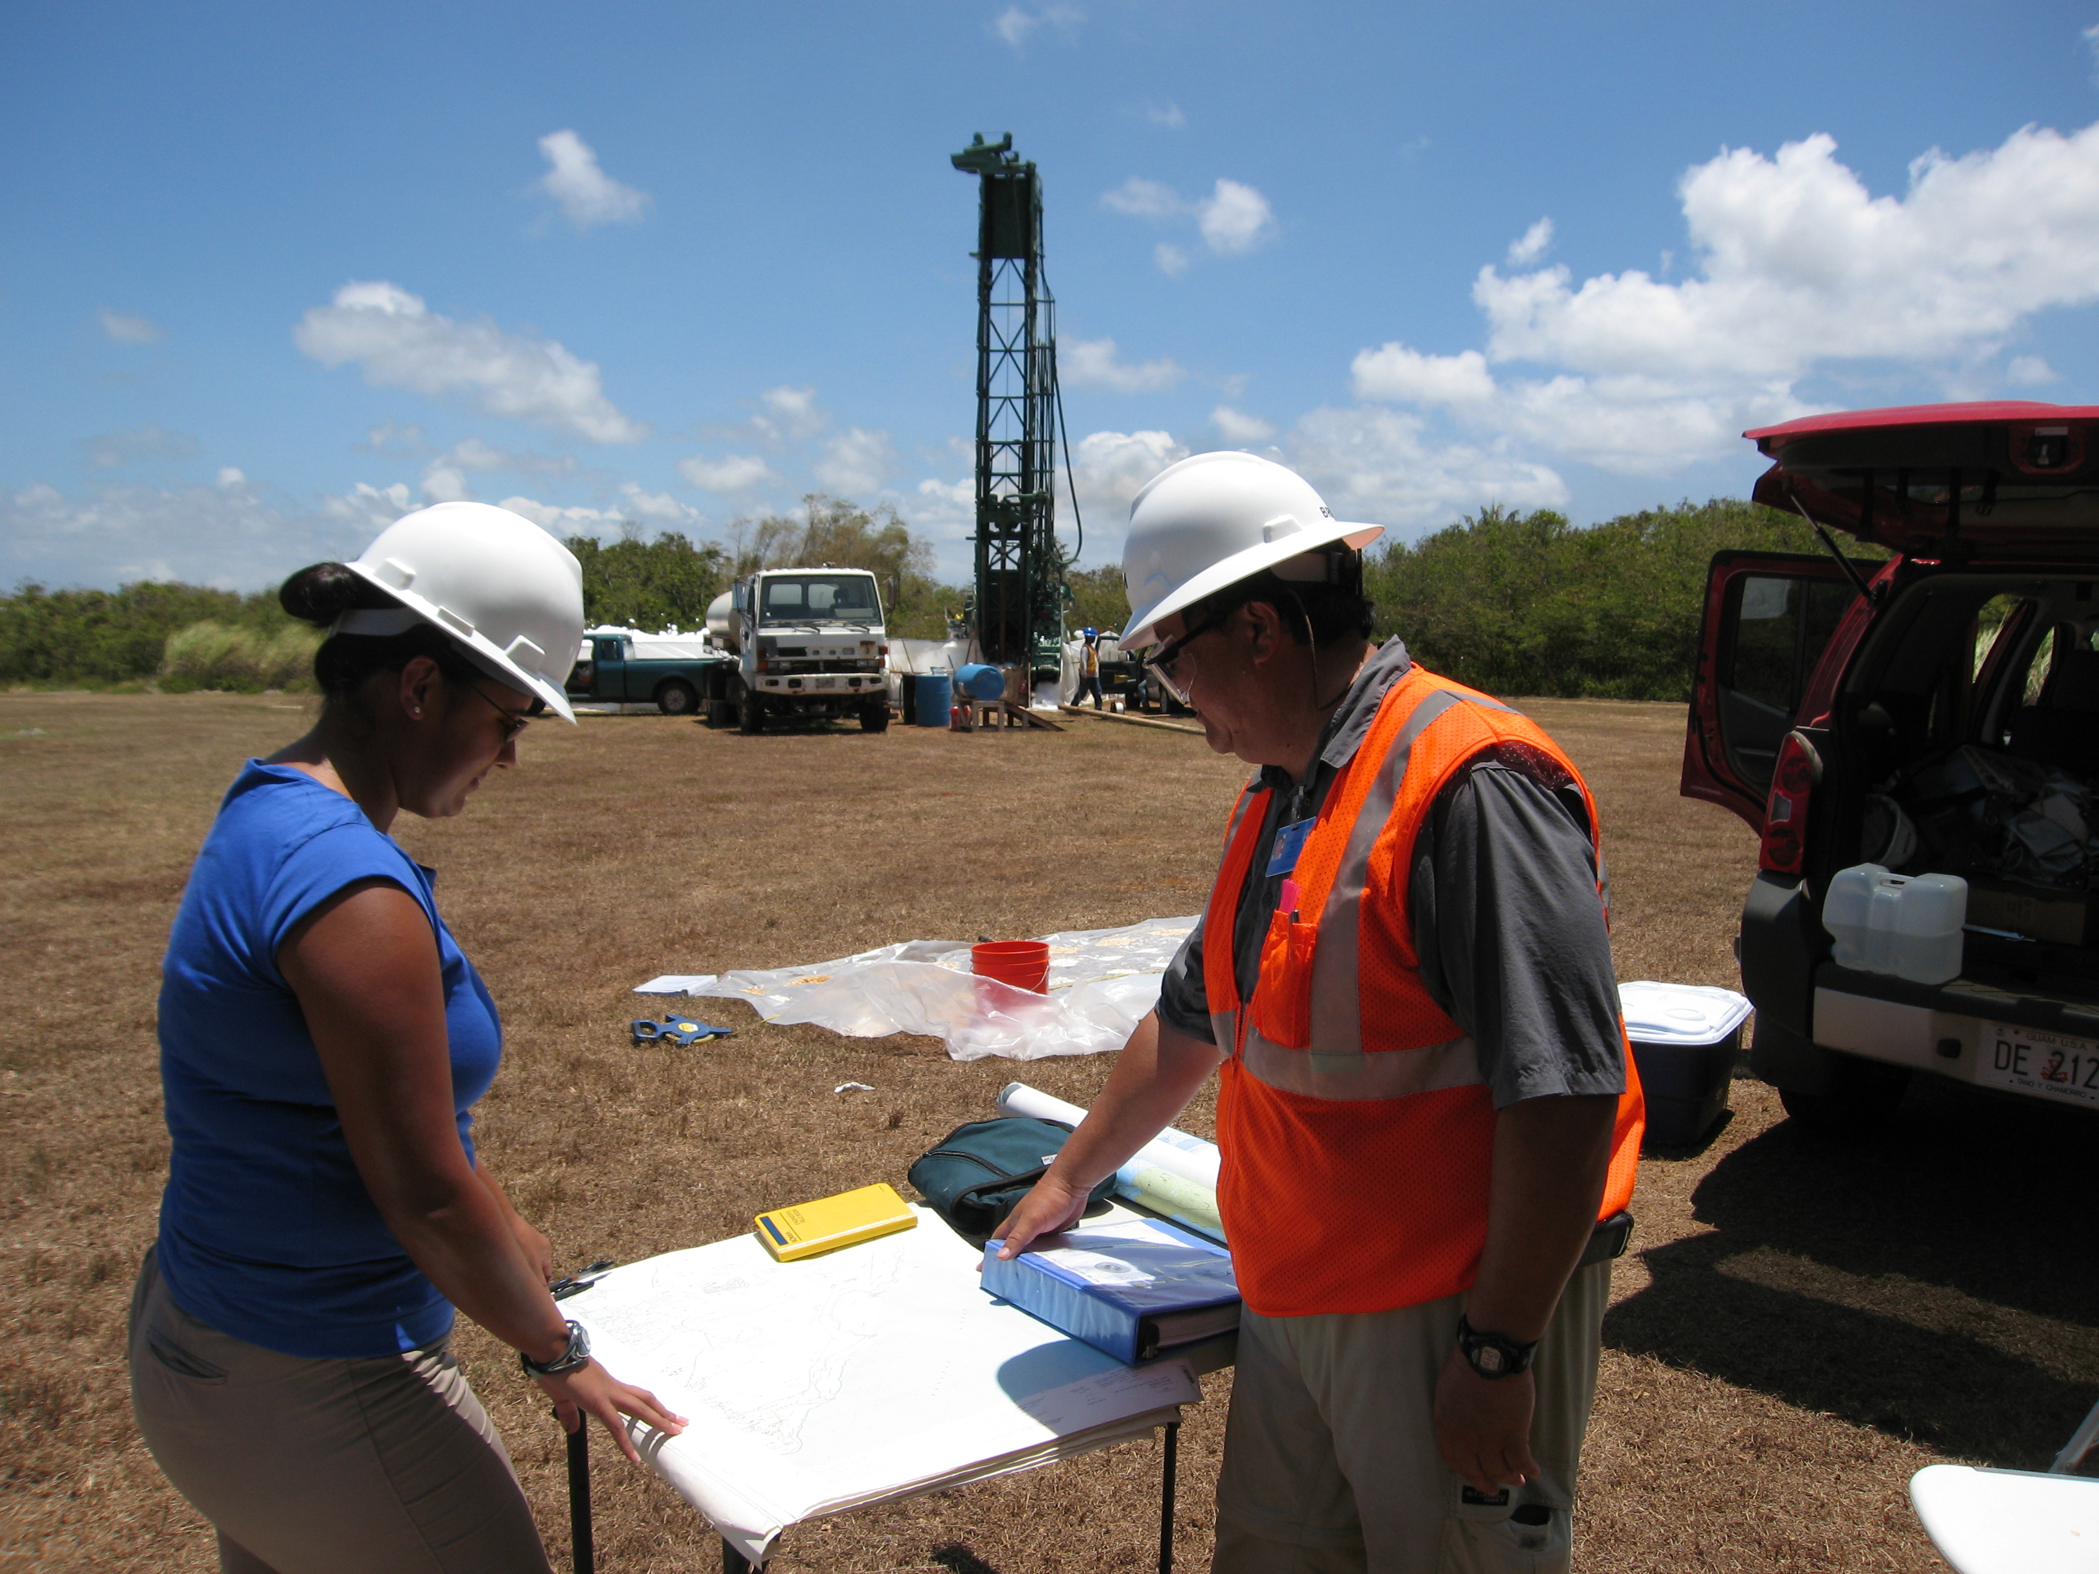
Purpose of the Workshops
Provide Guam’s professional community with working knowledge of WERI’s primary tools:
  Aquifer Database
    WERI Technical Report #141
  Aquifer Basement Map
    WERI Technical Report #142
  Aquifer Salinity Studies
    WERI Technical Reports #98 and #143
To promote successful groundwater exploration and aquifer management, including optimal well placement, design, and operation

Slide 5
Today’s Program
Time | min | Topic | Instructors
08:00 | 30 | Sign-in, coffee and donuts, WERI room 105
08:30 | 15 | Welcome and workshop overview | Jenson (WERI Director)
08:45 | 40 | NGLA review | weri.uog.edu | guamhydrologicsurvey.uog.edu Northern Guam Lens Aquifer Database, Map, and Videos | Habana
09:30 | 30 | Sinkholes in the NGLA | Kottermair
10:00 | 30 | Break
10:30 | 60 | Crosstalk Forum: Production well rehabilitation and lessons learned | Polevich, Railey, Marquez, Shambach
11:30 | 45 | Working lunch | Q&A session: Well rehabilitation and lessons learned
12:15 | 45 | Deep Observation Wells in the Yigo-Tumon Basin: EX-7, EX-10, GD | Dougher, Habana, Jenson, Lander
13:00 | 30 | MSERP - Monitoring System Expansion and Rehabilitation Program OGAMP – One Guam Aquifer Monitoring Program | Bautista, Jenson
13:30 | 15-30 | End of session | feedback forms | Jenson

Slide 6
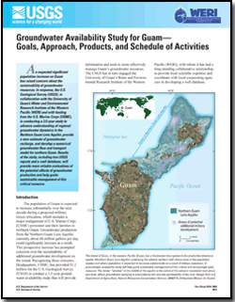

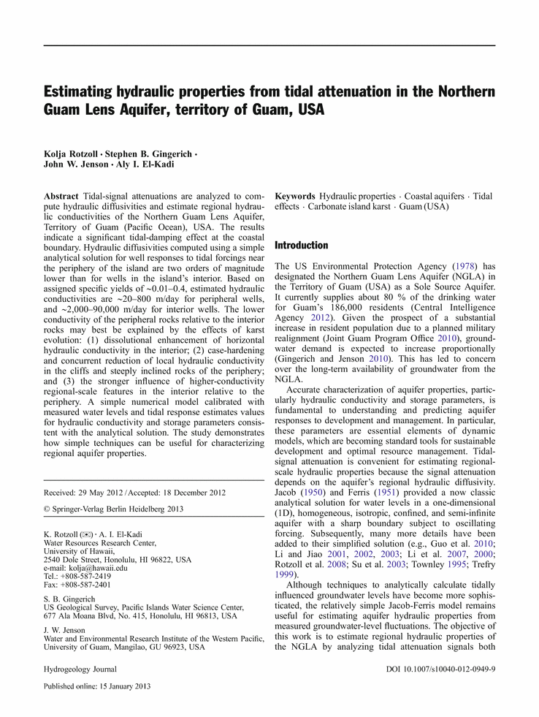
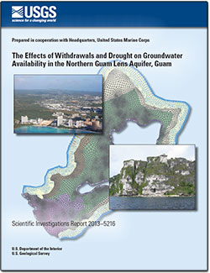
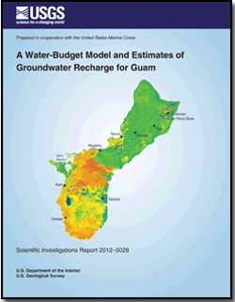
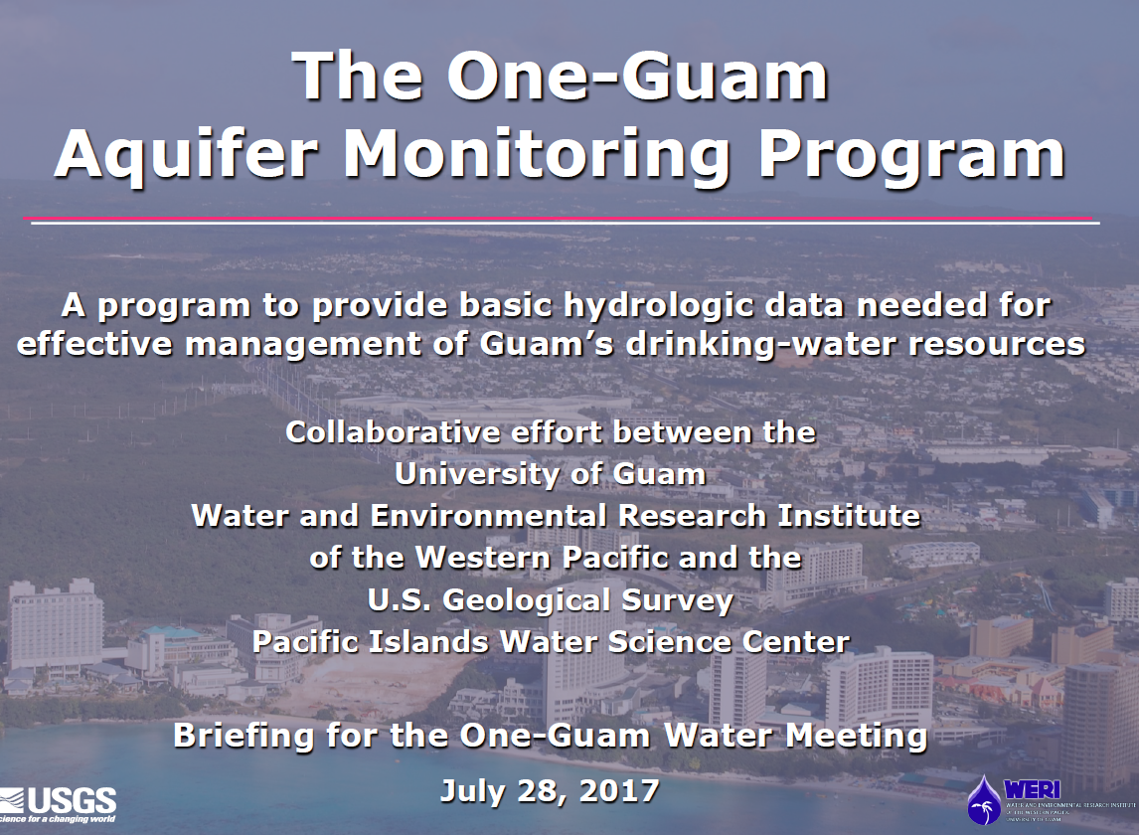
Decade 2010 - 2020
The Effects of Withdrawals and Drought on Groundwater Availability in the Northern Guam Lens Aquifer, Guam
Gingerich (2013)
http://hi.water.usgs.gov/publications/pubsguam.html
Notes:
In September 2013, we concluded a previous collaboration, led by Steve, and sponsored by the US Marine Corps, in which we built and applied a new, 3-D, groundwater model to examine the likely effects of expected increases in withdrawal…and possible natural stresses—such as El Nino-induced drought, on the aquifer.
The study was directed—of course—at the very obvious and practical question of how the existing system of water wells would respond to new stresses. It’s a tool for assessing the limits of the existing system.
Among the major “take-homes” from it was that, given the locations, depths, and pumping rates of wells in the system that we’ve inherited from the past six decades of development…we would be asking a lot of it to deliver much more production while still delivering the quality we have now.

Slide 7
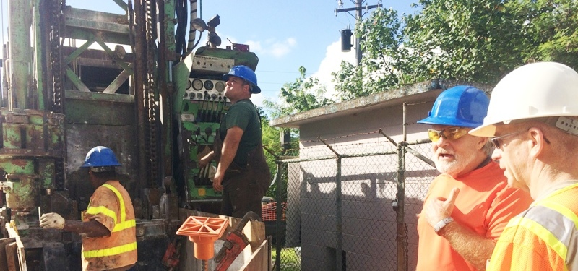
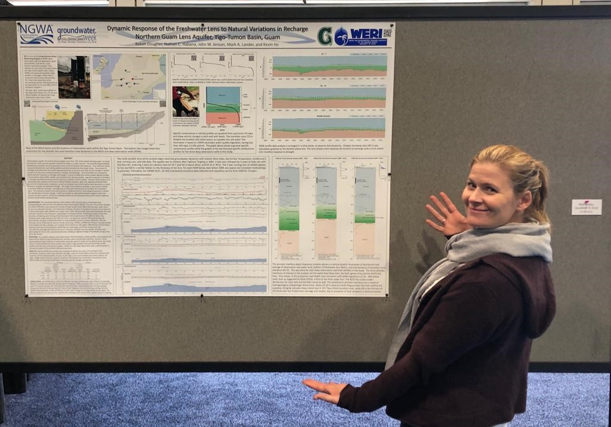
2017 to 2020

